Slide 2
John 20:1-18

Slide 4
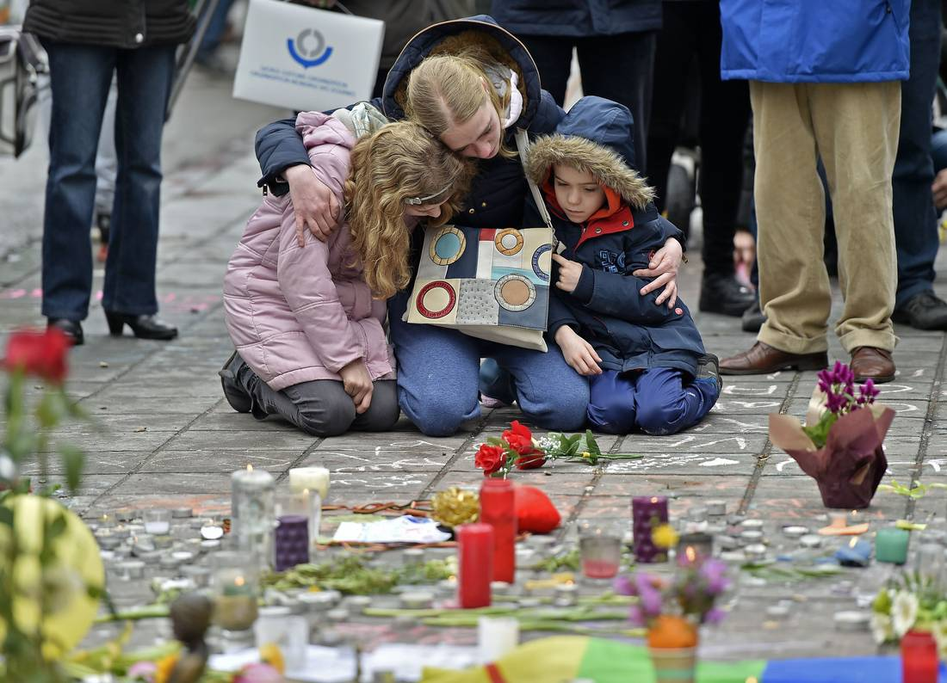

Slide 5
The heart of the Christian message is good news.
Hope is real.
And it’s centred on the resurrection of Jesus Christ.

Slide 6
Mark 1:1
¹ The beginning of the gospel about Jesus Christ, the Son of God.

Slide 7
What is the Resurrection?

Slide 8
Why is Jesus’ resurrection good news?

Slide 9
The resurrection offers
hope for the world

Slide 10
The resurrection offers hope for each of us

Slide 11
The resurrection offers hope for the future

