Slide 1
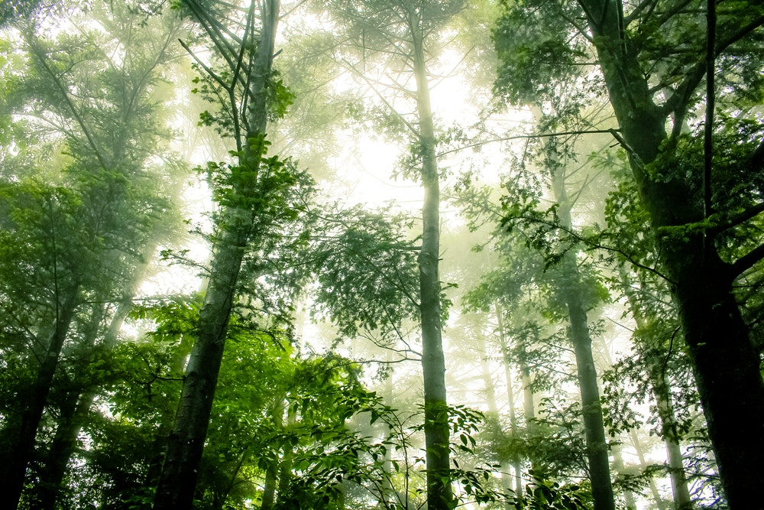
Identity

Slide 2
Psalm 139: 13
For You created my inmost being; you knit me together in my mother’s womb. I praise you because I am fearfully and wonderfully made; your works are wonderful, I know that full well. My frame was not hidden from you when I was made in the secret place, when I was woven together in the depths of the earth. Your eyes saw my unformed body; all the days ordained for me were written in your book before one of them came to be. How precious to me are your thoughts, God! How vast is the sum of them! Were I to count them, they would outnumber the grains of sand – when I awake, I am still with you.

Slide 4
I am
justified

Slide 5
Romans 3:23-24
“All have sinned and fall short of the glory of God, being justified freely by His grace through the redemption that is in Christ Jesus.”

Slide 6
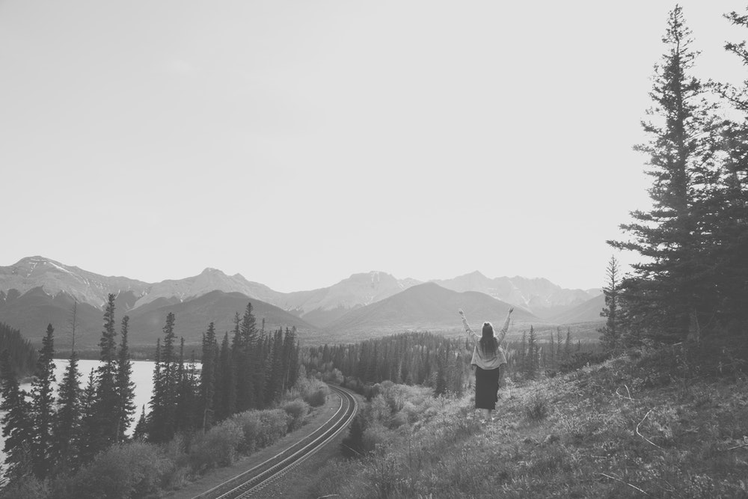
I am redeemed

Slide 7
Romans 3:23-24
“All have sinned and fall short of the glory of God, being justified freely by His grace through the redemption that is in Christ Jesus.”

Slide 8
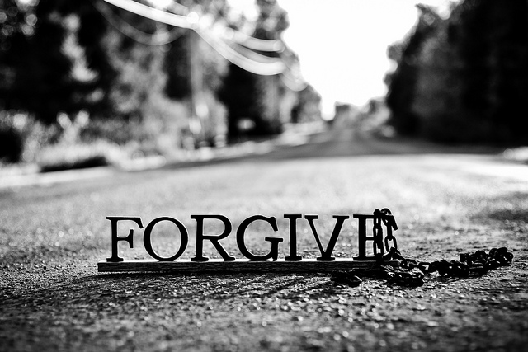
I am Forgiven

Slide 9
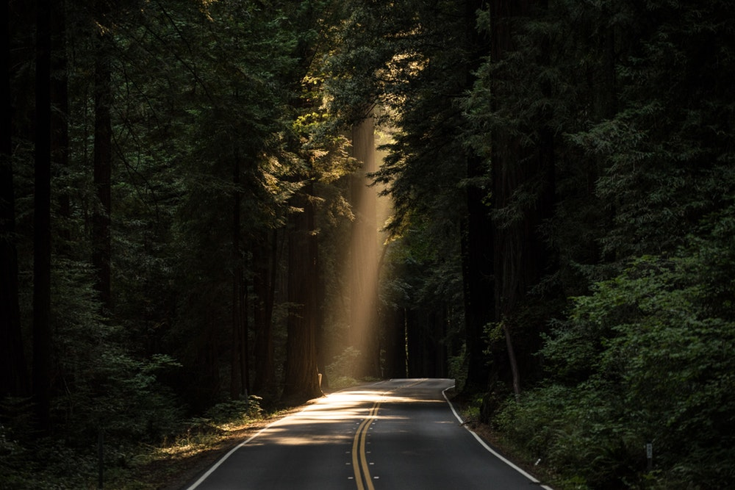
Ephesians 1:7
In Him we have redemption through His blood, the forgiveness of sins

Slide 10
I am
Chosen

Slide 11
2 Thessalonians 2:13-14
But we are bound to give thanks to God always for you, brethren beloved by the Lord, because God from the beginning chose you for salvation through sanctification by the Spirit and belief in the truth, to which He called you by our gospel, for the obtaining of the glory of our Lord Jesus Christ

Slide 12
I am being
Sanctified

Slide 13
2 Thessalonians 2:13-14
But we are bound to give thanks to God always for you, brethren beloved by the Lord, because God from the beginning chose you for salvation through sanctification by the Spirit and belief in the truth, to which He called you by our gospel, for the obtaining of the glory of our Lord Jesus Christ

Slide 14
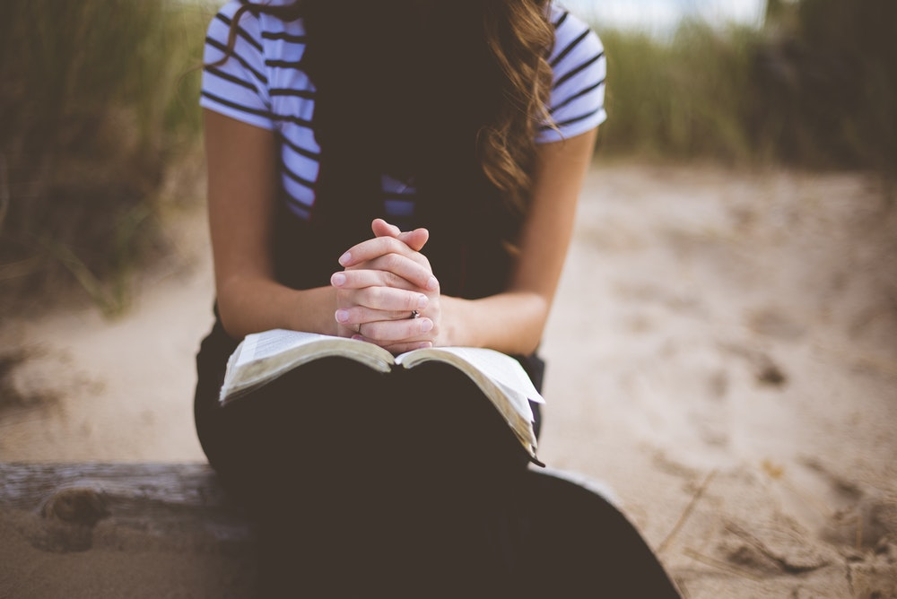
I will go through trials

Slide 15
James 1: 2-4
“My brethren, count it all joy when you fall into various trials, knowing that the testing of your faith produces patience. But let patience have its perfect work, that you may be perfect and complete, lacking nothing.”

Slide 16
We need to believe
God’s promises

Slide 17
Philippians 4:6
“Be anxious for nothing, but in everything by prayer and supplication, with thanksgiving, let your requests be made known to God; and the peace of God, which surpasses all understanding, will guard your hearts and minds through Christ Jesus.”

Slide 18
Mathew 11:28
“Come to Me, all you who labor and are heavy laden, and I will give you rest.”

Slide 19
Romans 8:28
“And we know that for those who love God all things work together for good, for those who are called according to his purpose.”

