Slide 2
“Therefore, my brothers and sisters, when you come together…welcome one another.” (1 Cor. 11:33)
“Whenever you come together, each one has a hymn, a teaching, a revelation, a tongue, or an interpretation. Everything is to be done for building up.” (1 Cor 14:26)
“For where two or three are gathered together in my name, I am there among them.”” (Matt 18:20)

Slide 3
“Therefore encourage one another and build each other up as you are already doing.” (1 Thessalonians 5:11)
“And let us consider one another in order to provoke love and good works, not neglecting to gather together, as some are in the habit of doing, but encouraging each other, and all the more as you see the day approaching.” (Hebrews 10:24–25)

Slide 5
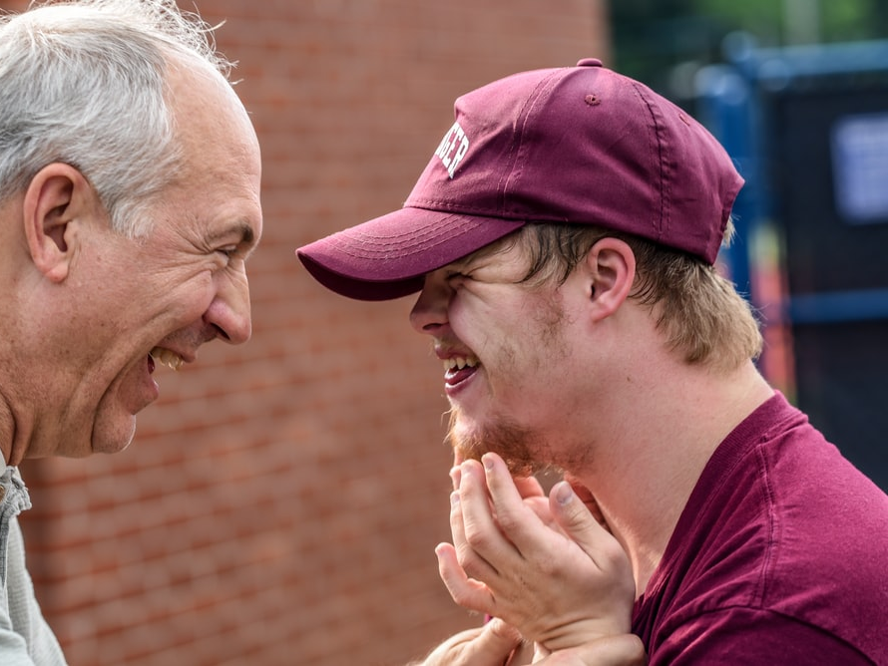
Moving deeper into authentic connection and community

Slide 6
“Now that you have purified yourselves by obeying the truth so that you have sincere love for each other, love one another deeply, from the heart.”
1 Peter 1:22

Slide 7
“How can we deepen and mature our fellowship, friendships, and connections with one another?”

Slide 8
Learning the skills necessary for
soul keeping

Slide 9
“What good is it for someone to gain the whole world, yet forfeit their soul?”
Mark 8:36

Slide 10
“How do we guard unhurried spaces for soul keeping?”

Slide 11
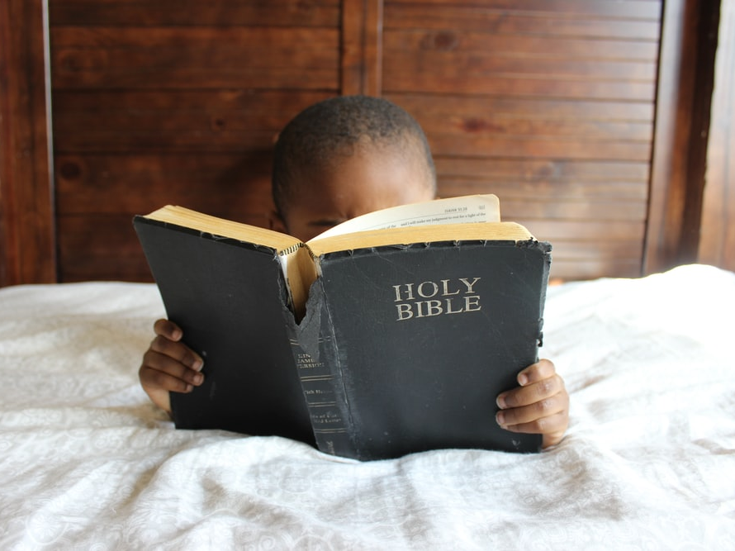
Deepening our ability to feast on God’s Word.

Slide 12
“Give us today our daily bread.” Matthew 6:11

Slide 13
“How do we deepen and mature our practice of feasting upon God’s Word daily?”

Slide 14
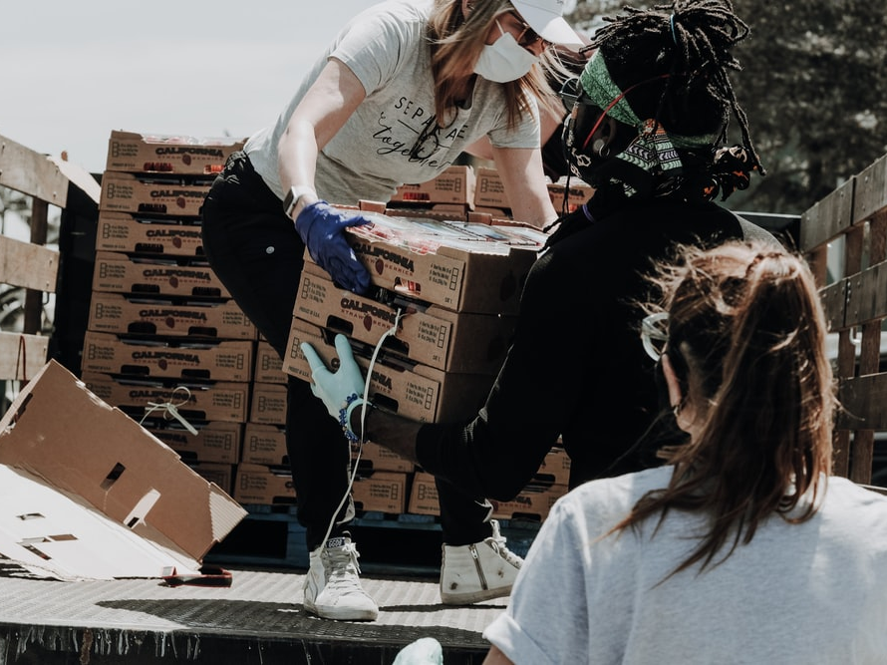
The need for us to foster a faith that works

Slide 15
“What good is it, my brothers and sisters, if someone claims to have faith but does not have works? Can such faith save him? If a brother or sister is without clothes and lacks daily food and one of you says to them, “Go in peace, stay warm, and be well fed,” but you don’t give them what the body needs, what good is it?”
James 2:14–16

Slide 16
“Where is God compelling us to put our faith to work on behalf of each other, the broader community, and the world?”

