Slide 1
WHY?
Reflections on a life in missions

Slide 2
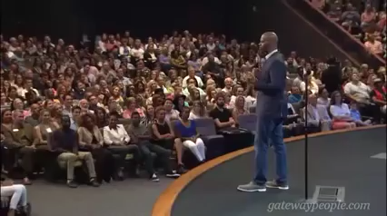

Slide 3
In missions, I have been involved with many different activities and ministries.
I have found it of critical importance to stay in touch with the “Why” behind “what” I do.

Slide 4
Missions - What’s my why?
That out of my own genuine experience of abiding in the love of God, others would know him.

Slide 5

The Source
Remain in me, and I will remain in you. For a branch cannot produce fruit if it is severed from the vine, and you cannot be fruitful unless you remain in me.
John 15:4

Slide 6
Sometimes we lose focus…
An easy pitfall for those in missions is a motivation of obligation and performance.

Slide 7
If we step out of Abiding:
We can move in to a works based mentality.
Feelings of inadequacy.
Pressure to perform and maintain an image.
A transactional approach in how we relate to people.
At an extreme, burnout.

Slide 8

Commands such as this can Elicit different responses in us,
depending on our filter.
Abiding relationship or Works mentality?
“Therefore go and make disciples of all nations, baptising them in the name of the Father and of the Son and of the Holy Spirit, 20 and teaching them to obey everything I have commanded you. And surely I am with you always, to the very end of the age.”
- Matthew 28:19

Slide 9
¹³ You formed my innermost being, shaping my delicate inside
and my intricate outside,
and wove them all together in my mother’s womb.^{[d]}
¹⁴ I thank you, God, for making me so mysteriously complex!
Everything you do is marvelously breathtaking.
It simply amazes me to think about it!
Psalm 139

Slide 10
How thoroughly you know me, Lord!
¹⁵ You even formed every bone in my body
when you created me in the secret place,^{[e]}
carefully, skillfully shaping me^{[f]} from nothing to something.
¹⁶ You saw who you created me to be before I became me!^{[g]}
Before I’d ever seen the light of day,
the number of days you planned for me
were already recorded in your book.^{[h]}
^{17–18} Every single moment you are thinking of me!
How precious and wonderful to consider
that you cherish me constantly in your every thought!
O God, your desires toward me are more
than the grains of sand on every shore!
When I awake each morning, you’re still with me.

Slide 11
Missions - What’s my why?
That out of my own genuine experience of abiding in the love of God, others would know him.

Slide 12
What have I been up to?
Let me show you!

Slide 13


Slide 15
Questions & Response

