Slide 2
Ephesians 3:14-21

Slide 3
¹⁴ For this reason I kneel before the Father, ¹⁵ from whom every family in heaven and on earth derives its name. ¹⁶ I pray that out of his glorious riches he may strengthen you with power through his Spirit in your inner being, ¹⁷ so that Christ may dwell in your hearts through faith. And I pray that you, being rooted and established in love,

Slide 4
¹⁸ may have power, together with all the Lord’s holy people, to grasp how wide and long and high and deep is the love of Christ, ¹⁹ and to know this love that surpasses knowledge—that you may be filled to the measure of all the fullness of God.
²⁰ Now to him who is able to do immeasurably more than all we ask or

Slide 5
imagine, according to his power that is at work within us, ²¹ to him be glory in the church and in Christ Jesus throughout all generations, for ever and ever! Amen.

Slide 6
Two Prayers for Power

Slide 7
Prayer #1

Slide 8
¹⁶ I pray that out of his glorious riches he may strengthen you with power [dynamis] through his Spirit in your inner being, ¹⁷ so that Christ may dwell [katoikeo] in your hearts through faith.

Slide 9
katoikeo

Slide 10
Prayer #2

Slide 11
And I pray that you, being rooted and established in love, ¹⁸ may have power [exischyo], together with all the Lord’s holy people, to grasp [katalambano] how wide and long and high and deep is the love of Christ, ¹⁹ and to know this love that surpasses knowledge—that you may be filled [pleroo] to the measure of all the fullness of God.

Slide 12
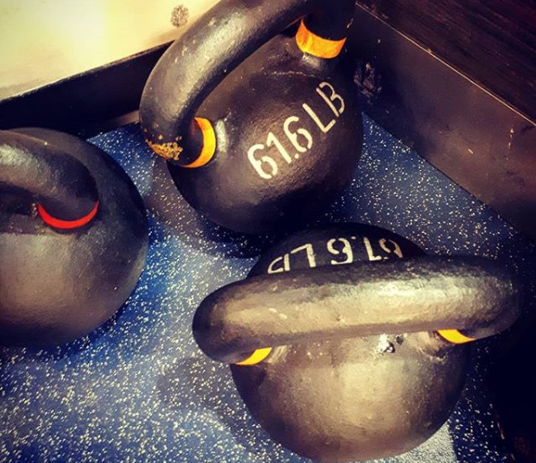
exischyo
katalambano

Slide 13
And I pray that you, being rooted and established in love, ¹⁸ may have power [exischyo], together with all the Lord’s holy people, to grasp [katalambano] how wide and long and high and deep is the love of Christ, ¹⁹ and to know this love that surpasses knowledge—that you may be filled [pleroo] to the measure of all the fullness of God.

Slide 14
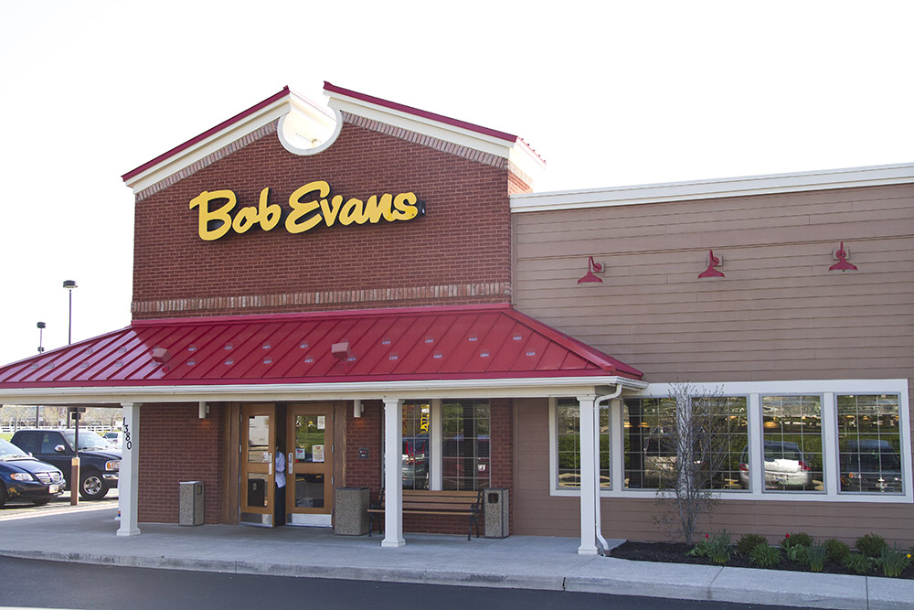
pleroo

Slide 15
An Exuberant Doxology

Slide 16
²⁰ Now to him who is able to do immeasurably more than all we ask or
imagine, according to his power [dynamis] that is at work [energeo] within us, ²¹ to him be glory in the church and in Christ Jesus throughout all generations, for ever and ever! Amen.

Slide 17
Applying the Text

Slide 18
Prioritize the centre and not the circumference.

Slide 19
Pray these prayers!

