Slide 2
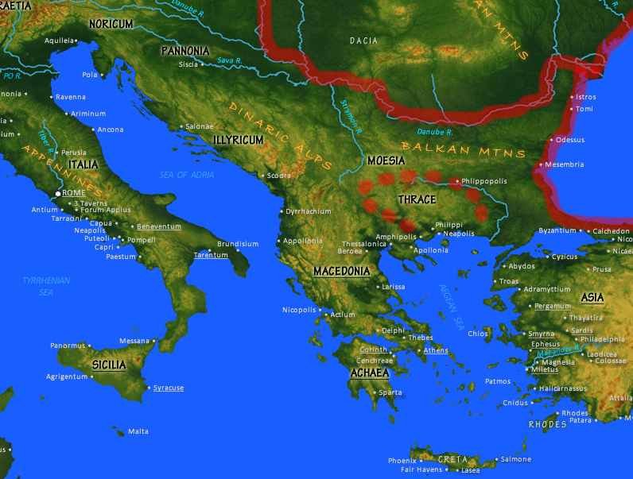

Slide 3
1:1-3
Who you are | Where you are | What you have
1:3-14
A Word of Glory (doxology)
1:15-23
A Pray for Enlightenment

Slide 4
2:1-10
(Re)created for the world!
2:11-22
A new humanity (one in Christ!)

Slide 5
Ephesians 3:1-13

Slide 6
¹ For this reason I, Paul, the prisoner of Christ Jesus for the sake of you Gentiles— ² Surely you have heard about the administration of God’s grace that was given to me for you, ³ that is, the mystery made known to me by revelation, as I have already written briefly. ⁴ In reading this, then, you will be able to understand my insight into the mystery of Christ, , ⁵ which was not made known to people in other generations

Slide 7
as it has now been revealed by the Spirit to God’s holy apostles and prophets. ⁶ This mystery is that through the gospel the Gentiles are heirs together with Israel, members together of one body, and sharers together in the promise in Christ Jesus. ⁷ I became a servant of this gospel by the gift of God’s grace given me through the working of his power. ⁸ Although I am less than the least of all the Lord’s people, this grace was

Slide 8
given me: to preach to the Gentiles the boundless riches of Christ, ⁹ and to make plain to everyone the administration of this mystery, which for ages past was kept hidden in God, who created all things. ¹⁰ His intent was that now, through the church, the manifold wisdom of God should be made known to the rulers and authorities in the heavenly realms, ¹¹ according to his eternal purpose that he accomplished in

Slide 9
Christ Jesus our Lord. ¹² In him and through faith in him we may approach God with freedom and confidence. ¹³ I ask you, therefore, not to be discouraged because of my sufferings for you, which are your glory.

Slide 10
Ephesians 3:1-13

Slide 11
¹ For this reason I, Paul, the prisoner of Christ Jesus for the sake of you Gentiles— ² Surely you have heard about the administration of God’s grace that was given to me for you, ³ that is, the mystery made known to me by revelation, as I have already written briefly. ⁴ In reading this, then, you will be able to understand my insight into the mystery of Christ, , ⁵ which was not made known to people in other generations

Slide 12
v. 1 “For this reason I, Paul, the prisoner of Christ Jesus for the sake of you Gentiles…”
You can have confidence in hardship.

Slide 13
¹ For this reason I, Paul, the prisoner of Christ Jesus for the sake of you Gentiles— ² Surely you have heard about the administration of God’s grace that was given to me for you, ³ that is, the mystery made known to me by revelation, as I have already written briefly. ⁴ In reading this, then, you will be able to understand my insight into the mystery of Christ, , ⁵ which was not made known to people in other generations

Slide 14
v. 4 “The mystery is that through the gospel the Gentiles are…”
i) heirs together with Israel
ii) members together of the one body
iii) sharers together in the promise

Slide 15
The gospel establishes a radical spiritual egalitarianism

Slide 16
¹ For this reason I, Paul, the prisoner of Christ Jesus for the sake of you Gentiles— ² Surely you have heard about the administration of God’s grace that was given to me for you, ³ that is, the mystery made known to me by revelation, as I have already written briefly. ⁴ In reading this, then, you will be able to understand my insight into the mystery of Christ, , ⁵ which was not made known to people in other generations

Slide 17
as it has now been revealed by the Spirit to God’s holy apostles and prophets. ⁶ This mystery is that through the gospel the Gentiles are heirs together with Israel, members together of one body, and sharers together in the promise in Christ Jesus. ⁷ I became a servant of this gospel by the gift of God’s grace given me through the working of his power. ⁸ Although I am less than the least of all the Lord’s people, this grace was

Slide 18
v. 7 “I became a servant of this gospel…”
Grace always brings responsibility; it is never merely privilege.

Slide 19
given me: to preach to the Gentiles the boundless riches of Christ, ⁹ and to make plain to everyone the administration of this mystery, which for ages past was kept hidden in God, who created all things. ¹⁰ His intent was that now, through the church, the manifold wisdom of God should be made known to the rulers and authorities in the heavenly realms, ¹¹ according to his eternal purpose that he accomplished in

Slide 20
v. 8 “boundless riches in Christ”
“boundless” = anexichniastos impossible to understand, unfathomable, impossible to comprehend.

Slide 21
Christ Jesus our Lord. ¹² In him and through faith in him we may approach God with freedom and confidence. ¹³ I ask you, therefore, not to be discouraged because of my sufferings for you, which are your glory.

Slide 22
v. 12 “in him and through faith in him we may approach God with freedom and confidence.”
Paul’s concern is not for access to heaven at some future day, but access to God in the present.

Slide 23
Ephesians 3:1-13

Slide 24
1. Are you stuck and chained to less-than-ideal circumstances? What does it look like for you to serve Christ through them?

Slide 25
2. Who are you “in chains” for? What ministry have you been graced with?

Slide 26
3. Are we learning to explore the riches of Christ?
Heart: learning to cultivate spiritual friendships
Soul: learning to pray and worship
Mind: learning to faithfully understand and apply the Bible
Strength: learn to serve/give for the sake of others

Slide 27
4. Is our church, in the sort of life it leads, posing the kind of challenge to the powers of evil which provokes a reaction?

