Slide 2
Mark 15:1-15

Slide 3
¹ Very early in the morning, the chief priests, with the elders, the teachers of the law and the whole Sanhedrin, made their plans. So they bound Jesus, led him away and handed him over to Pilate. ² “Are you the king of the Jews?” asked Pilate. “You have said so,” Jesus replied. ³ The chief priests accused him of many things. ⁴ So again Pilate asked him, “Aren’t you going to answer? See how many things they are accusing you of.” ⁵ But Jesus still made no reply, and Pilate was amazed.

Slide 4
⁶ Now it was the custom at the festival to release a prisoner whom the people requested. ⁷ A man called Barabbas was in prison with the insurrectionists who had committed murder in the uprising. ⁸ The crowd came up and asked Pilate to do for them what he usually did. ⁹ “Do you want me to release to you the king of the Jews?” asked Pilate, ¹⁰ knowing it was out of self-interest that the chief priests had handed Jesus over to him. ¹¹ But the chief priests stirred up the crowd to have Pilate release Barabbas instead.

Slide 5
¹² “What shall I do, then, with the one you call the king of the Jews?” Pilate asked them. ¹³ “Crucify him!” they shouted. ¹⁴ “Why? What crime has he committed?” asked Pilate. But they shouted all the louder, “Crucify him!” ¹⁵ Wanting to satisfy the crowd, Pilate released Barabbas to them. He had Jesus flogged, and handed him over to be crucified.

Slide 6
¹ Very early in the morning, the chief priests, with the elders, the teachers of the law and the whole Sanhedrin, made their plans. So they bound Jesus, led him away and handed him over to Pilate. ² “Are you the king of the Jews?” asked Pilate. “You have said so,” Jesus replied. ³ The chief priests accused him of many things. ⁴ So again Pilate asked him, “Aren’t you going to answer? See how many things they are accusing you of.” ⁵ But Jesus still made no reply, and Pilate was amazed.

Slide 7
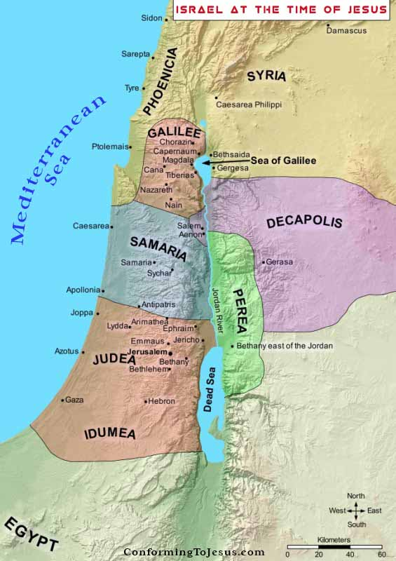

Slide 8
¹ Very early in the morning, the chief priests, with the elders, the teachers of the law and the whole Sanhedrin, made their plans. So they bound Jesus, led him away and handed him over to Pilate. ² “Are you the king of the Jews?” asked Pilate. “You have said so,” Jesus replied. ³ The chief priests accused him of many things. ⁴ So again Pilate asked him, “Aren’t you going to answer? See how many things they are accusing you of.” ⁵ But Jesus still made no reply, and Pilate was amazed.

Slide 9
¹ Very early in the morning, the chief priests, with the elders, the teachers of the law and the whole Sanhedrin, made their plans. So they bound Jesus, led him away and handed him over to Pilate. ² “Are you the king of the Jews?” asked Pilate. “You have said so,” Jesus replied. ³ The chief priests accused him of many things. ⁴ So again Pilate asked him, “Aren’t you going to answer? See how many things they are accusing you of.” ⁵ But Jesus still made no reply, and Pilate was amazed.

Slide 10
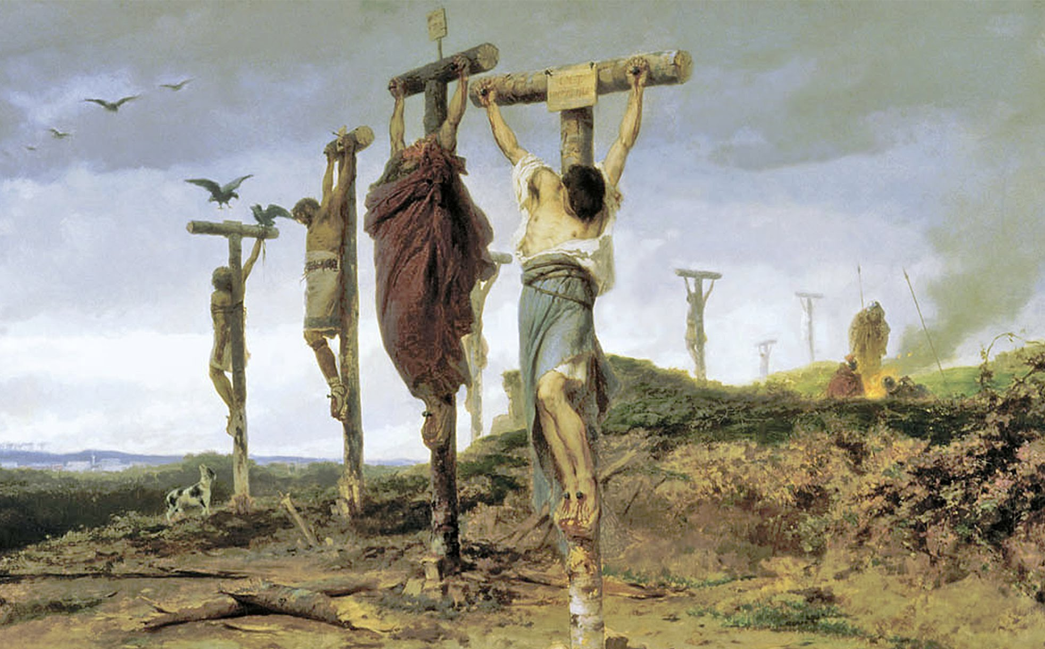

Slide 11
⁶ Now it was the custom at the festival to release a prisoner whom the people requested. ⁷ A man called Barabbas was in prison with the insurrectionists who had committed murder in the uprising. ⁸ The crowd came up and asked Pilate to do for them what he usually did. ⁹ “Do you want me to release to you the king of the Jews?” asked Pilate, ¹⁰ knowing it was out of self-interest that the chief priests had handed Jesus over to him. ¹¹ But the chief priests stirred up the crowd to have Pilate release Barabbas instead.

Slide 12
⁶ Now it was the custom at the festival to release a prisoner whom the people requested. ⁷ A man called Barabbas was in prison with the insurrectionists who had committed murder in the uprising. ⁸ The crowd came up and asked Pilate to do for them what he usually did. ⁹ “Do you want me to release to you the king of the Jews?” asked Pilate, ¹⁰ knowing it was out of self-interest that the chief priests had handed Jesus over to him. ¹¹ But the chief priests stirred up the crowd to have Pilate release Barabbas instead.

Slide 13
¹² “What shall I do, then, with the one you call the king of the Jews?” Pilate asked them. ¹³ “Crucify him!” they shouted. ¹⁴ “Why? What crime has he committed?” asked Pilate. But they shouted all the louder, “Crucify him!” ¹⁵ Wanting to satisfy the crowd, Pilate released Barabbas to them. He had Jesus flogged, and handed him over to be crucified.

Slide 14
¹² “What shall I do, then, with the one you call the king of the Jews?” Pilate asked them. ¹³ “Crucify him!” they shouted. ¹⁴ “Why? What crime has he committed?” asked Pilate. But they shouted all the louder, “Crucify him!” ¹⁵ Wanting to satisfy the crowd, Pilate released Barabbas to them. He had Jesus flogged, and handed him over to be crucified.

Slide 15
¹² “What shall I do, then, with the one you call the king of the Jews?” Pilate asked them. ¹³ “Crucify him!” they shouted. ¹⁴ “Why? What crime has he committed?” asked Pilate. But they shouted all the louder, “Crucify him!” ¹⁵ Wanting to satisfy the crowd, Pilate released Barabbas to them. He had Jesus flogged, and handed him over to be crucified.

Slide 17
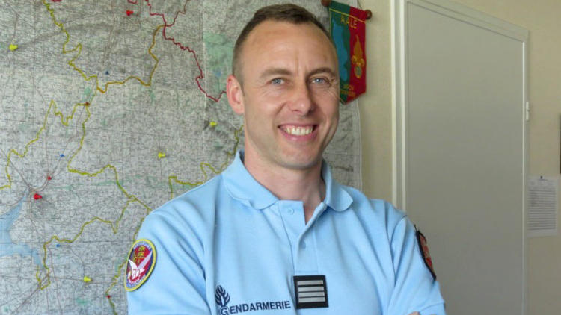
French Lieutenant Colonel Arnaud Beltrame

Slide 18
Jesus didn’t just save us as Barabbas’s Jesus saved us to be Barabbas’s

Slide 19
Galatians 3:26 ²⁶ You are all sons of God through faith in Christ Jesus. Galatians 4:4–7 ⁴ But when the time had fully come, God sent his Son, born of a woman, born under law, ⁵ to redeem those under law, that we might receive the full rights of sons. ⁶ Because you are sons, God sent the Spirit of his Son into our hearts, the Spirit who calls out, “Abba, Father.” ⁷ So you are no longer a slave, but a son; and since you are a son, God has made you also an heir.

