Slide 2
Mark 14:32-42

Slide 3
³² They went to a place called Gethsemane, and Jesus said to his disciples, “Sit here while I pray.” ³³ He took Peter, James and John along with him, and he began to be deeply distressed and troubled. ³⁴ “My soul is overwhelmed with sorrow to the point of death,” he said to them. “Stay here and keep watch.” ³⁵ Going a little farther, he fell to the ground and prayed that if possible the hour might pass from him.

Slide 4
³⁶ “Abba, Father,” he said, “everything is possible for you. Take this cup from me. Yet not what I will, but what you will.” ³⁷ Then he returned to his disciples and found them sleeping. “Simon,” he said to Peter, “are you asleep? Couldn’t you keep watch for one hour? ³⁸ Watch and pray so that you will not fall into temptation. The spirit is willing, but the flesh is weak.” ³⁹ Once more he went away and prayed the same thing.

Slide 5
⁴⁰ When he came back, he again found them sleeping, because their eyes were heavy. They did not know what to say to him. ⁴¹ Returning the third time, he said to them, “Are you still sleeping and resting? Enough! The hour has come. Look, the Son of Man is delivered into the hands of sinners. ⁴² Rise! Let us go! Here comes my betrayer!”

Slide 7
³² They went to a place called Gethsemane, and Jesus said to his disciples, “Sit here while I pray.” ³³ He took Peter, James and John along with him, and he began to be deeply distressed and troubled. ³⁴ “My soul is overwhelmed with sorrow to the point of death,” he said to them. “Stay here and keep watch.” ³⁵ Going a little farther, he fell to the ground and prayed that if possible the hour might pass from him.

Slide 8
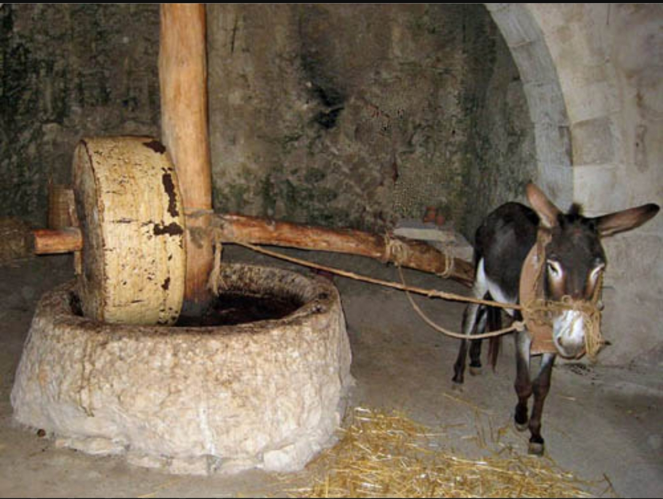

Slide 9
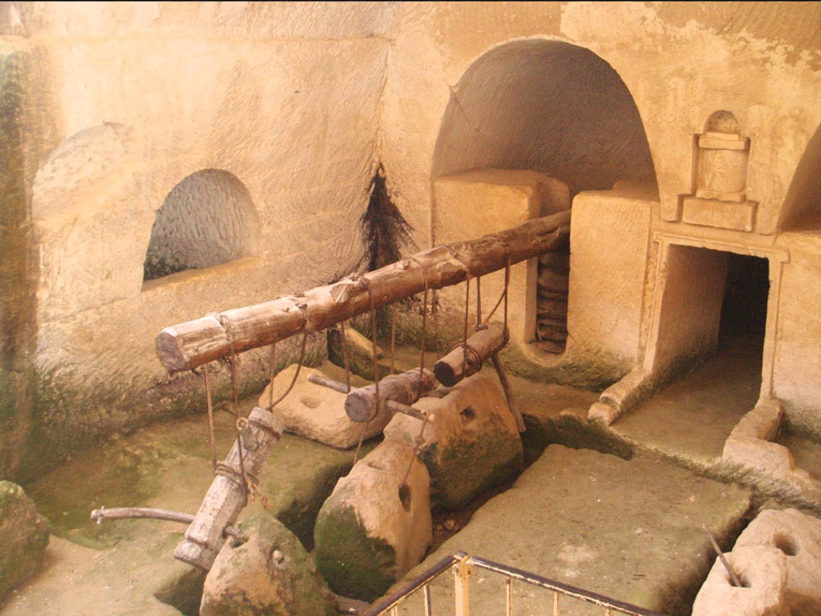

Slide 10
³² They went to a place called Gethsemane, and Jesus said to his disciples, “Sit here while I pray.” ³³ He took Peter, James and John along with him, and he began to be deeply distressed and troubled. ³⁴ “My soul is overwhelmed with sorrow to the point of death,” he said to them. “Stay here and keep watch.” ³⁵ Going a little farther, he fell to the ground and prayed that if possible the hour might pass from him.

Slide 11
³² They went to a place called Gethsemane, and Jesus said to his disciples, “Sit here while I pray.” ³³ He took Peter, James and John along with him, and he began to be deeply distressed and troubled. ³⁴ “My soul is overwhelmed with sorrow to the point of death,” he said to them. “Stay here and keep watch.” ³⁵ Going a little farther, he fell to the ground and prayed that if possible the hour might pass from him.

Slide 12
³² They went to a place called Gethsemane, and Jesus said to his disciples, “Sit here while I pray.” ³³ He took Peter, James and John along with him, and he began to be deeply distressed and troubled. ³⁴ “My soul is overwhelmed with sorrow to the point of death,” he said to them. “Stay here and keep watch.” ³⁵ Going a little farther, he fell to the ground and prayed that if possible the hour might pass from him.

Slide 13
³⁶ “Abba, Father,” he said, “everything is possible for you. Take this cup from me. Yet not what I will, but what you will.” ³⁷ Then he returned to his disciples and found them sleeping. “Simon,” he said to Peter, “are you asleep? Couldn’t you keep watch for one hour? ³⁸ Watch and pray so that you will not fall into temptation. The spirit is willing, but the flesh is weak.” ³⁹ Once more he went away and prayed the same thing.

Slide 14
Jeremiah 25:15–17 15 This is what the Lord, the God of Israel, said to me: “Take from my hand this cup filled with the wine of my wrath and make all the nations to whom I send you drink it. 16 When they drink it, they will stagger and go mad because of the sword I will send among them.” 17 So I took the cup from the Lord’s hand and made all the nations to whom he sent me drink it:
Isaiah 51:17 17 Awake, awake! Rise up, Jerusalem, you who have drunk from the hand of the Lord the cup of his wrath, you who have drained to its dregs the goblet that makes people stagger.

Slide 15
³⁶ “Abba, Father,” he said, “everything is possible for you. Take this cup from me. Yet not what I will, but what you will.” ³⁷ Then he returned to his disciples and found them sleeping. “Simon,” he said to Peter, “are you asleep? Couldn’t you keep watch for one hour? ³⁸ Watch and pray so that you will not fall into temptation. The spirit is willing, but the flesh is weak.” ³⁹ Once more he went away and prayed the same thing.

Slide 16
³⁶ “Abba, Father,” he said, “everything is possible for you. Take this cup from me. Yet not what I will, but what you will.” ³⁷ Then he returned to his disciples and found them sleeping. “Simon,” he said to Peter, “are you asleep? Couldn’t you keep watch for one hour? ³⁸ Watch and pray so that you will not fall into temptation. The spirit is willing, but the flesh is weak.” ³⁹ Once more he went away and prayed the same thing.

Slide 17
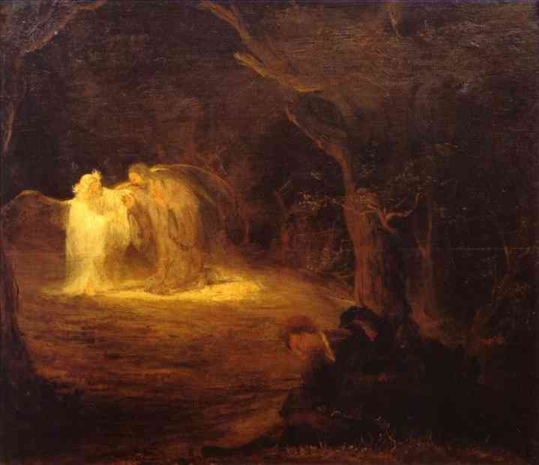

Slide 18
“And being in anguish, he prayed more earnestly, and his sweat was like drops of blood falling to the ground.” Luke 22:44

Slide 19
⁴⁰ When he came back, he again found them sleeping, because their eyes were heavy. They did not know what to say to him. ⁴¹ Returning the third time, he said to them, “Are you still sleeping and resting? Enough! The hour has come. Look, the Son of Man is delivered into the hands of sinners. ⁴² Rise! Let us go! Here comes my betrayer!”

Slide 20
⁴⁰ When he came back, he again found them sleeping, because their eyes were heavy. They did not know what to say to him. ⁴¹ Returning the third time, he said to them, “Are you still sleeping and resting? Enough! The hour has come. Look, the Son of Man is delivered into the hands of sinners. ⁴² Rise! Let us go! Here comes my betrayer!”

Slide 21
⁴⁰ When he came back, he again found them sleeping, because their eyes were heavy. They did not know what to say to him. ⁴¹ Returning the third time, he said to them, “Are you still sleeping and resting? Enough! The hour has come. Look, the Son of Man is delivered into the hands of sinners. ⁴² Rise! Let us go! Here comes my betrayer!”

Slide 22
Jesus took the cup of wrath so you could have the cup of salvation.

Slide 23
Jesus entered the Gethsemane so that you could enter eternal life.

