Slide 1
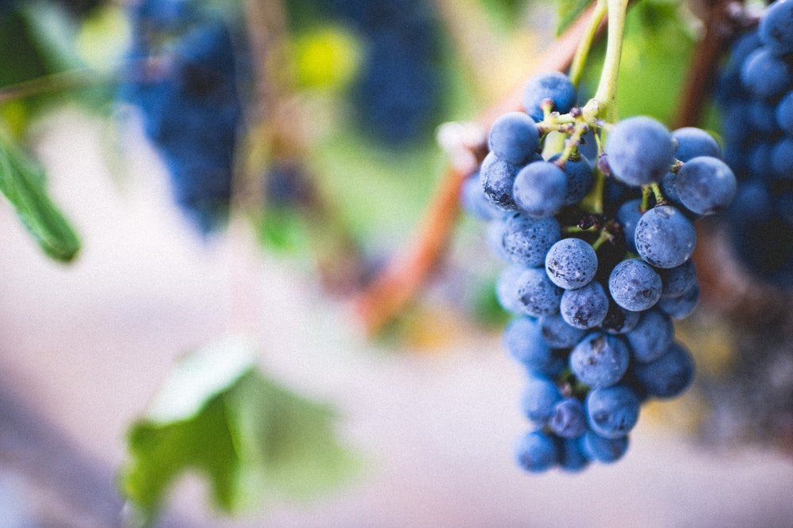
ABIDE

Slide 2
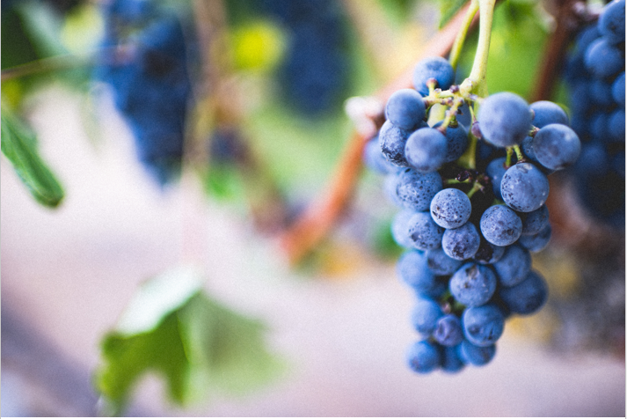
¹ “I am the true vine, and my Father is the gardener. ² He cuts off every branch in me that bears no fruit, while every branch that does bear fruit he prunes so that it will be even more fruitful. ³ You are already clean because of the word I have spoken to you.

Slide 3
⁴ Remain in me, and I will remain in you. No branch can bear fruit by itself; it must remain in the vine. Neither can you bear fruit unless you remain in me. ⁵ “I am the vine; you are the branches. If a man remains in me and I in him, he will bear much fruit; apart from me you can do nothing.

Slide 4
⁶ If anyone does not remain in me, he is like a branch that is thrown away and withers; such branches are picked up, thrown into the fire and burned. ⁷ If you remain in me and my words remain in you, ask whatever you wish, and it will be given you. ⁸ This is to my Father’s glory, that you bear much fruit, showing yourselves to be my disciples.

Slide 5
⁹ “As the Father has loved me, so have I loved you. Now remain in my love. ¹⁰ If you obey my commands, you will remain in my love, just as I have obeyed my Father’s commands and remain in his love. ¹¹ I have told you this so that my joy may be in you and that your joy may be complete.

Slide 7
Characteristics of Christians who grow in depth and fruitfulness.
Build rituals
Maintain accountability
Grow through hardships
Practice spiritual disciplines
Establish all activity in the gospel of grace

Slide 9
Living in the
Overlap of the Ages

Slide 10
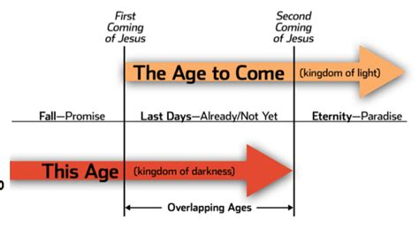

Slide 11
1 Peter 5:6–11
6 Humble yourselves, therefore, under God’s mighty hand, that he may lift you up in due time. 7 Cast all your anxiety on him because he cares for you. 8 Be self-controlled and alert. Your enemy the devil prowls around like a roaring lion looking for someone to devour. 9 Resist him, standing firm in the faith, because you know that

Slide 12
your brothers throughout the world are undergoing the same kind of sufferings. 10 And the God of all grace, who called you to his eternal glory in Christ, after you have suffered a little while, will himself restore you and make you strong, firm and steadfast. 11 To him be the power for ever and ever. Amen.

Slide 13
How to Suffer Fruitfully

Slide 14
Get your eyes off yourself (v. 6)
Take time to lament (v. 7)
Watch out! (v. 8)
Resist the enemy by standing firm in the faith (v. 9)
Live in anticipation of God's strengthening (v. 10)

Slide 15
ABIDE

