Slide 1
Re:new
living in light of the resurrection

Slide 2
A Faith That Bears Fruit

Slide 3
1. Seek spiritual growth, both alone and with others 2. Are keenly aware of God 3. Act out of a commitment to faith in Jesus Christ 4. Make Christian faith a way of life (the Jesus “way”) 5. Live lives of service

Slide 4
6. Reach out to others who are different or in need. 7. Exercise moral responsibility 8. Speak publicly about faith 9. Possess a positive, hopeful spirit towards others and toward life.

Slide 5
How Do We Get There?

Slide 6
1. We Need a Bigger Story

Slide 7
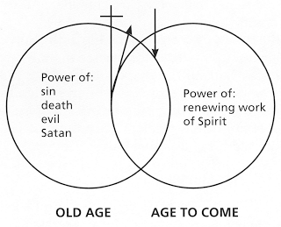

Slide 8
happiness and success wisdom and vocation

Slide 9
2. We Need a Better Game Plan

Slide 10
Parents of young children

Slide 11
The Importance of Catechesis catechize, “echo back”

Slide 12
New City Catechism www.newcitycatechism.com

Slide 13
Family Mission Statement

Slide 14
We are not here for ourselves; we live to honor God. We want to “go viral” for Jesus We want to “hang loose” for Jesus We make no small plans

Slide 15
Parents of teens

Slide 16
2 Principles: Grace and Truth 3 Priorities: Affirmation, Boundaries, Consequences

Slide 17
Parents of adult children

Slide 18
-Resource your children -Encourage them and ask how you can be praying for them -“What can I do to help?”

Slide 19
Beyond “Christian-ish”

Slide 20
¹⁰ I want to know Christ—yes, to know the power of his resurrection and participation in his sufferings, becoming like him in his death, ¹¹ and so, somehow, attaining to the resurrection from the dead. Philippians 3:10-11

Slide 21
Re:new
living in light of the resurrection

