Slide 1
Genesis 3:7-13
⁷ Then the eyes of both of them were opened, and they realized they were naked; so they sewed fig leaves together and made coverings for themselves.
⁸ Then the man and his wife heard the sound of the Lord God as he was walking in the garden in the cool of the day, and they hid from the Lord God among the trees of the garden. ⁹ But the Lord God called to the man, “Where are you?” ¹⁰ He answered, “I heard you in the garden, and I was afraid because I was naked; so I hid.”

Slide 2
Genesis 3:7-13
¹¹ And he said, “Who told you that you were naked? Have you eaten from the tree that I commanded you not to eat from?”
¹² The man said, “The woman you put here with me—she gave me some fruit from the tree, and I ate it.”
¹³ Then the Lord God said to the woman, “What is this you have done?” The woman said, “The serpent deceived me, and I ate.”

Slide 4
Genesis 3:7-13
⁷ Then the eyes of both of them were opened, and they realized they were naked; so they sewed fig leaves together and made coverings for themselves.
⁸ Then the man and his wife heard the sound of the Lord God as he was walking in the garden in the cool of the day, and they hid from the Lord God among the trees of the garden. ⁹ But the Lord God called to the man, “Where are you?” ¹⁰ He answered, “I heard you in the garden, and I was afraid because I was naked; so I hid.”

Slide 5
Genesis 3:7-13
¹¹ And he said, “Who told you that you were naked? Have you eaten from the tree that I commanded you not to eat from?”
¹² The man said, “The woman you put here with me—she gave me some fruit from the tree, and I ate it.”
¹³ Then the Lord God said to the woman, “What is this you have done?” The woman said, “The serpent deceived me, and I ate.”

Slide 6
The Fall

Slide 7
Hiding through noise/distraction

Slide 8
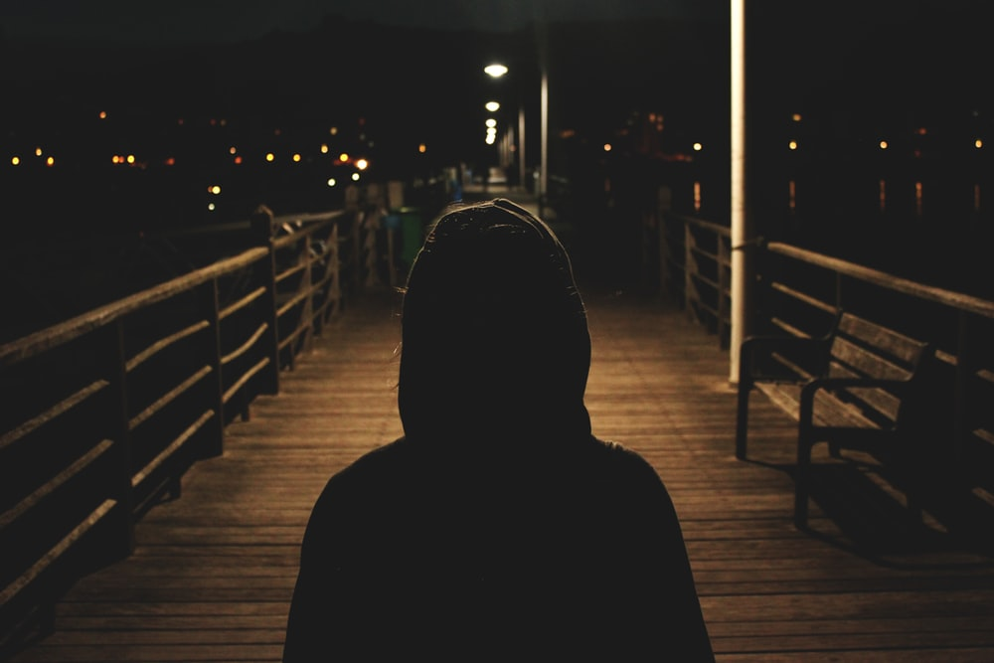
Hiding through avoidance of Christian community

Slide 9
Hiding through chemicals

Slide 10
Hiding through skepticism

Slide 11
Hiding through not taking responsibility for our choices

Slide 12
Hiding through hypocrisy

Slide 13
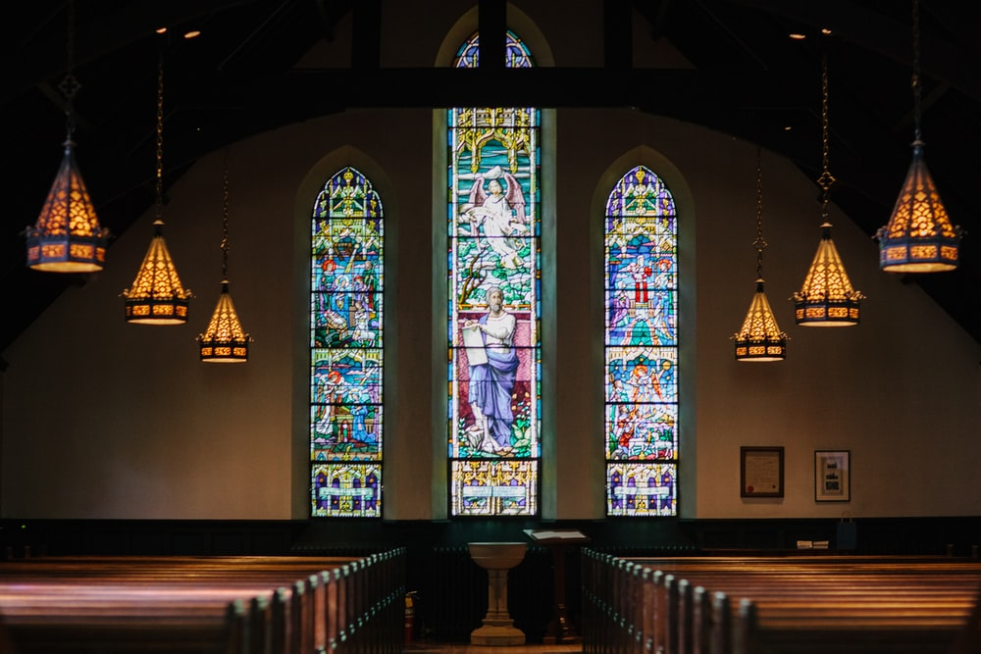
Hiding through religion/moralism

Slide 15
Hebrews 4:13 ¹³ Nothing in all creation is hidden from God’s sight. Everything is uncovered and laid bare before the eyes of him to whom we must give account.
Jeremiah 23:24 ²⁴ Can anyone hide in secret places so that I cannot see him?” declares the Lord. “Do not I fill heaven and earth?” declares the Lord.
Psalm 139:11–12 ¹¹ If I say, “Surely the darkness will hide me and the light become night around me,” ¹² even the darkness will not be dark to you; the night will shine like the day, for darkness is as light to you.

Slide 16
The Seeking…
⁹ But the Lord God called to the man, “Where are you?”

Slide 17
“For the Son of Man came to seek and to save what was lost.” Jesus, in Luke 19:10

