Slide 2
Mark 13

Slide 3
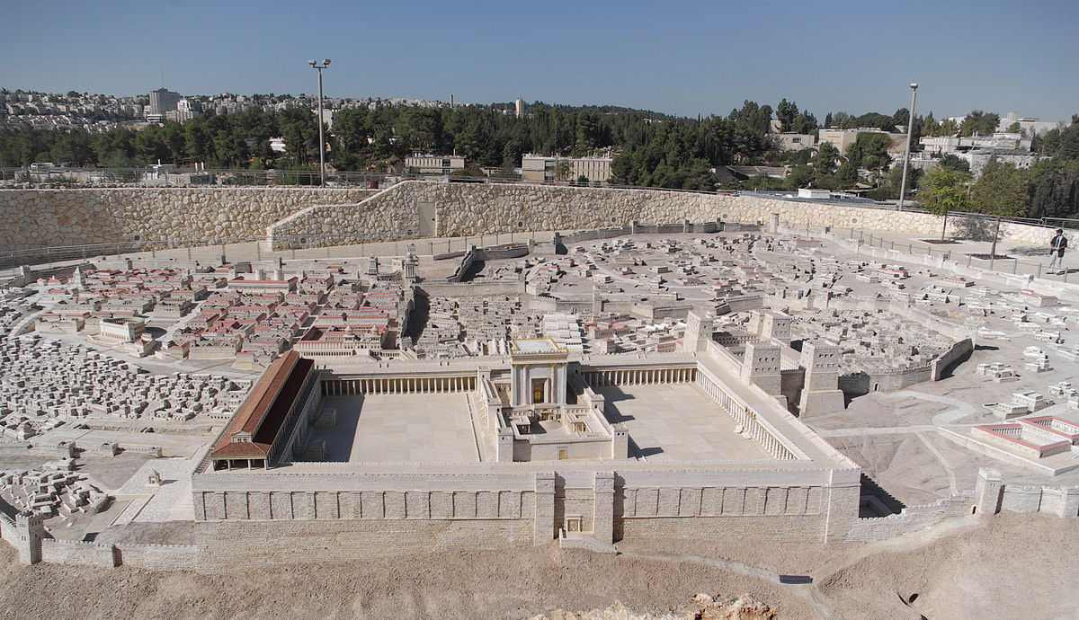

Slide 4
Mark 13

Slide 5
View A:
Mark 13 has everything to do with a final tribulation that will occur directly before Jesus returns.

Slide 6
View B:
Mark 13 is Jesus’ prediction of what is going to happen within 40 years of his resurrection and ascension.

Slide 7
View C:
Mark 13 is primarily focused on Jesus’ prediction of what is going to happen within 40 years of his resurrection and ascension, but points beyond the judgement of God on the Temple to a judgement that will occur upon his eventual return.

Slide 8
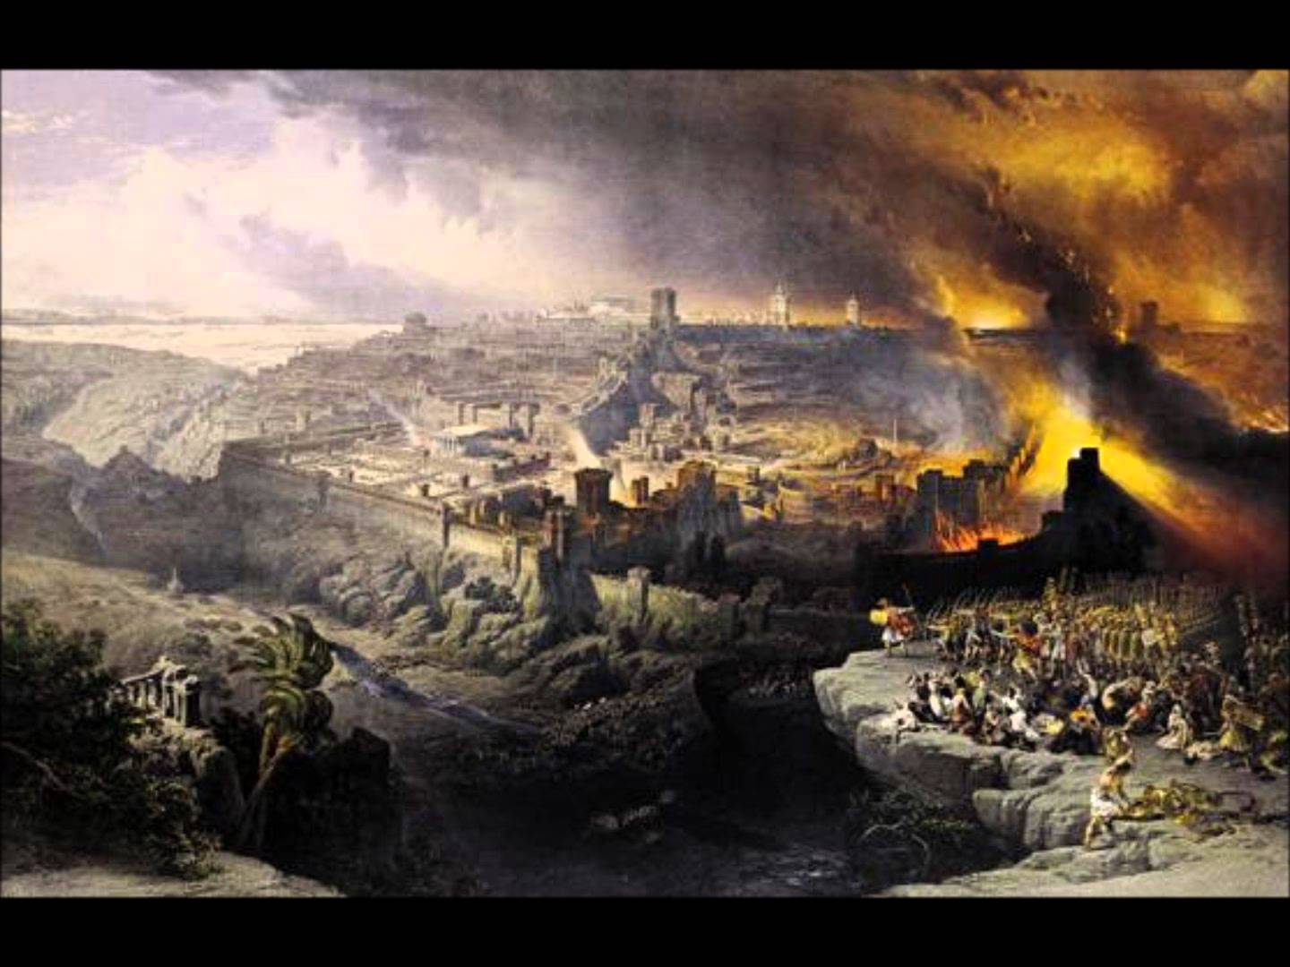

Slide 9
2 Thessalonians 1:6-10
6 God is just: He will pay back trouble to those who trouble you 7 and give relief to you who are troubled, and to us as well. This will happen when the Lord Jesus is revealed from heaven in blazing fire with his powerful angels. 8 He will punish those who do not know God and do not obey the gospel of our Lord Jesus. 9 They will be punished with everlasting destruction and shut out from the presence of the Lord and from the glory of his might 10 on the day he comes to be glorified in his holy people and to be marveled at among all those who have believed.

Slide 10
Take-Aways

Slide 11
Watch out that no one deceives you!
“Context is king!”

Slide 12
Watch out that no one deceives you!
“Context is king!”
The King is coming!
(cf. 2 Thessalonians 1:6-10)

