Slide 1
Heart: Fun with friends
Soul: Praying Scripture
Mind: Cultural currents
Strength: Serving neighbours

Slide 2
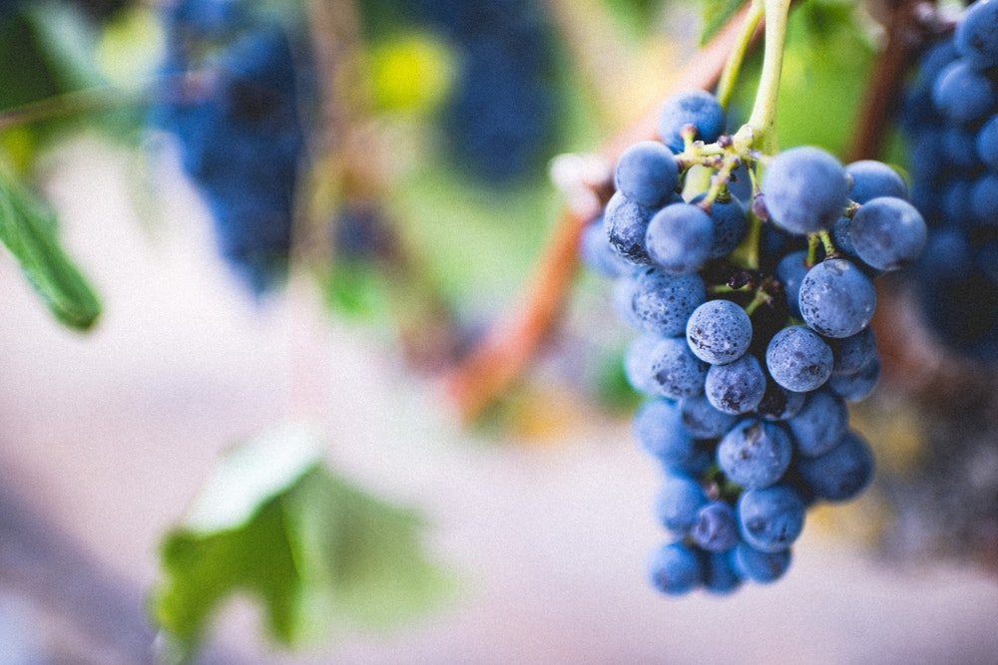
ABIDE

Slide 3
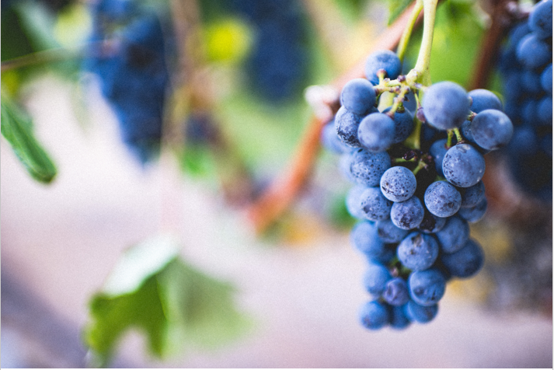
¹ “I am the true vine, and my Father is the gardener. ² He cuts off every branch in me that bears no fruit, while every branch that does bear fruit he prunes so that it will be even more fruitful. ³ You are already clean because of the word I have spoken to you.

Slide 4
⁴ Remain in me, and I will remain in you. No branch can bear fruit by itself; it must remain in the vine. Neither can you bear fruit unless you remain in me. ⁵ “I am the vine; you are the branches. If a man remains in me and I in him, he will bear much fruit; apart from me you can do nothing.

Slide 5
⁶ If anyone does not remain in me, he is like a branch that is thrown away and withers; such branches are picked up, thrown into the fire and burned. ⁷ If you remain in me and my words remain in you, ask whatever you wish, and it will be given you. ⁸ This is to my Father’s glory, that you bear much fruit, showing yourselves to be my disciples.

Slide 6
⁹ “As the Father has loved me, so have I loved you. Now remain in my love. ¹⁰ If you obey my commands, you will remain in my love, just as I have obeyed my Father’s commands and remain in his love. ¹¹ I have told you this so that my joy may be in you and that your joy may be complete.

Slide 7
¹² My command is this: Love each other as I have loved you. ¹³ Greater love has no one than this: to lay down one’s life for one’s friends. ¹⁴ You are my friends if you do what I command. ¹⁵ I no longer call you servants, because a servant does not know his master’s business. Instead, I have called you friends

Slide 8
for everything that I learned from my Father I have made known to you. ¹⁶ You did not choose me, but I chose you and appointed you so that you might go and bear fruit—fruit that will last—and so that whatever you ask in my name the Father will give you. ¹⁷ This is my command: Love each other.

Slide 10
Characteristics of Christians who grow in depth and fruitfulness.
Build rituals
Maintain accountability
Grow through hardships
Practice spiritual disciplines
Establish all activity in the gospel of grace

Slide 11
The importance of self-care as a spiritual discipline.

Slide 12
Mark 8:34-35
34 Then he called the crowd to him along with his disciples and said: “If anyone would come after me, he must deny himself and take up his cross and follow me. 35 For whoever wants to save his life will lose it, but whoever loses his life for me and for the gospel will save it.

Slide 13
Self-care to the glory of God
and good of neighbour.

Slide 14
“How can I best structure my life so that I can effectively and sustainably grow in my ability to love God and serve others?”

Slide 15
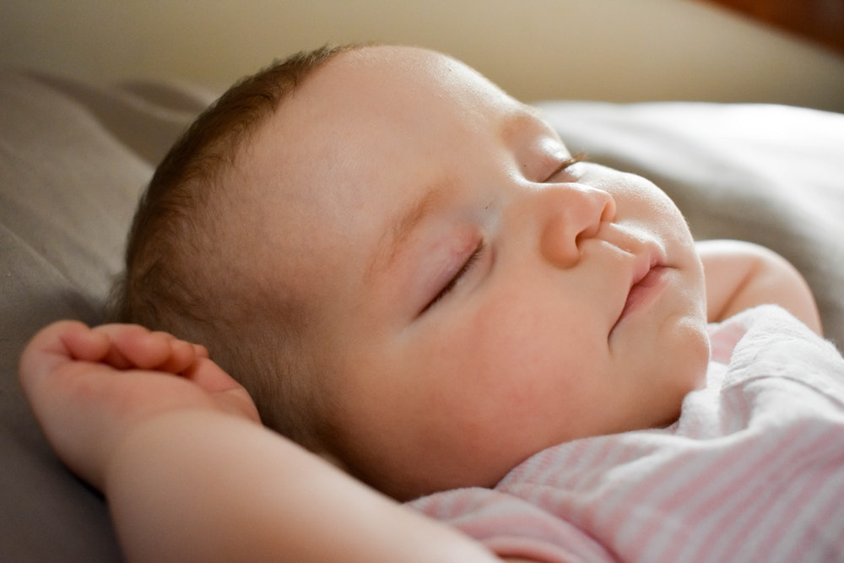

Slide 17
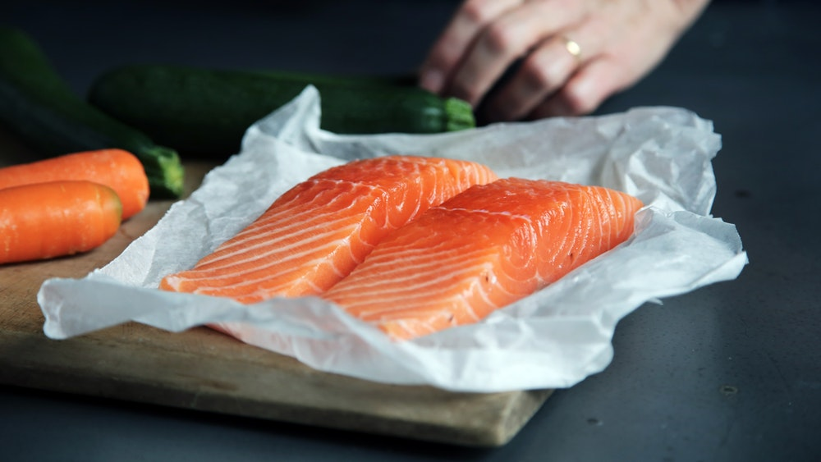

Slide 19
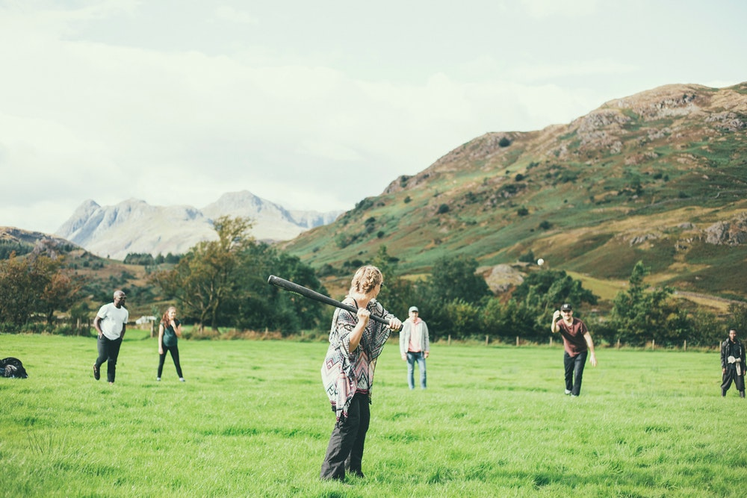

Slide 21
Sleep
Exercise
Nutrition
Sabbath
Re-creation
Processing emotions

Slide 22
Self-Care Temptations

Slide 23
ABIDE

