Slide 1
Re:new
living in light of the resurrection

Slide 2
12 “I have the right to do anything,” you say-but not everything is beneficial. “I have the right to do anything”-but I will not be mastered by anything. 13 You say, “Food for the stomach and the stomach for food, and God will destroy them both.” The body, however, is not meant for sexual immorality but for the Lord, and the

Slide 3
Lord for the body. 14 By his power God raised the Lord from the dead, and he will raise us also. 15 Do you not know that your bodies are members of Christ himself? Shall I then take the members of Christ and unite them with a prostitute? Never! 16 Do you not know that he who unites himself with a prostitute is one with her in body?

Slide 4
For it is said, “The two will become one flesh.” 17 But whoever is united with the Lord is one with him in spirit. 18 Flee from sexual immorality. All other sins a person commits are outside the body, but whoever sins sexually, sins against their own body. 19 Do you not know that your bodies are temples of the Holy Spirit, who is in you, whom you

Slide 5
have received from God? You are not your own; 20 you were bought at a price. Therefore honor God with your bodies.

Slide 6
Re:new
living in light of the resurrection

Slide 7
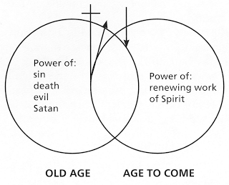

Slide 8
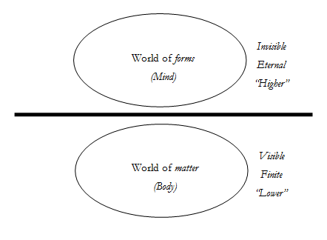

Slide 9
12 “I have the right to do anything,” you say-but not everything is beneficial. “I have the right to do anything”-but I will not be mastered by anything. 13 You say, “Food for the stomach and the stomach for food, and God will destroy them both.” The body, however, is not meant for sexual immorality but for the Lord, and the

Slide 10
Lord for the body. 14 By his power God raised the Lord from the dead, and he will raise us also. 15 Do you not know that your bodies are members of Christ himself? Shall I then take the members of Christ and unite them with a prostitute? Never! 16 Do you not know that he who unites himself with a prostitute is one with her in body?

Slide 11
For it is said, “The two will become one flesh.” 17 But whoever is united with the Lord is one with him in spirit. 18 Flee from sexual immorality. All other sins a person commits are outside the body, but whoever sins sexually, sins against their own body. 19 Do you not know that your bodies are temples of the Holy Spirit, who is in you, whom you

Slide 12
have received from God? You are not your own; 20 you were bought at a price. Therefore honor God with your bodies.

Slide 13
Our bodies and sexuality are a gift from God. Both have been corrupted by sin but are also arenas of God’s redemption.
All ideas that seek to undermine the inherent goodness or diminish the importance of our bodies or our sexuality need to be rejected.
What we do with our bodies sexually matter enormously because sex is a covenant-making activity that comprehensively shapes a person.

Slide 14
Whether unmarried or married, Christians are called to courageously consider how to “honor God with our bodies.”
Because our bodies and sexuality are an arena of God’s redemptive work, a negative, destructive, abusive sexual history can be redeemed in Christ.

Slide 15
Re:new
living in light of the resurrection

