Slide 2
Ephesians 1:3-14

Slide 3
³ Praise be to the God and Father of our Lord Jesus Christ, who has blessed us in the heavenly realms with every spiritual blessing in Christ. ⁴ For he chose us in him before the creation of the world to be holy and blameless in his sight. In love ⁵ he predestined us to be adopted as his sons through Jesus Christ, in accordance with his pleasure and will— ⁶ to the praise of his glorious grace, which he has freely given us in the One he loves.

Slide 4
⁷ In him we have redemption through his blood, the forgiveness of sins, in accordance with the riches of God’s grace ⁸ that he lavished on us with all wisdom and understanding. ⁹ And he made known to us the mystery of his will according to his good pleasure, which he purposed in Christ, ¹⁰ to be put into effect when the times will have reached their fulfillment—to bring all things in heaven and on earth together under one head, even Christ.

Slide 5
¹¹ In him we were also chosen, having been predestined according to the plan of him who works out everything in conformity with the purpose of his will, ¹² in order that we, who were the first to hope in Christ, might be for the praise of his glory. ¹³ And you also were included in Christ when you heard the word of truth, the gospel of your salvation.

Slide 6
Having believed, you were marked in him with a seal, the promised Holy Spirit, ¹⁴ who is a deposit guaranteeing our inheritance until the redemption of those who are God’s possession—to the praise of his glory.

Slide 7
Ephesians 1:1-3 Review

Slide 8
Who you are
Where you are
What you have

Slide 9
Every Christian is a saint

Slide 11
Every Christian is a saint
Every Christian is in the world and in Christ

Slide 12
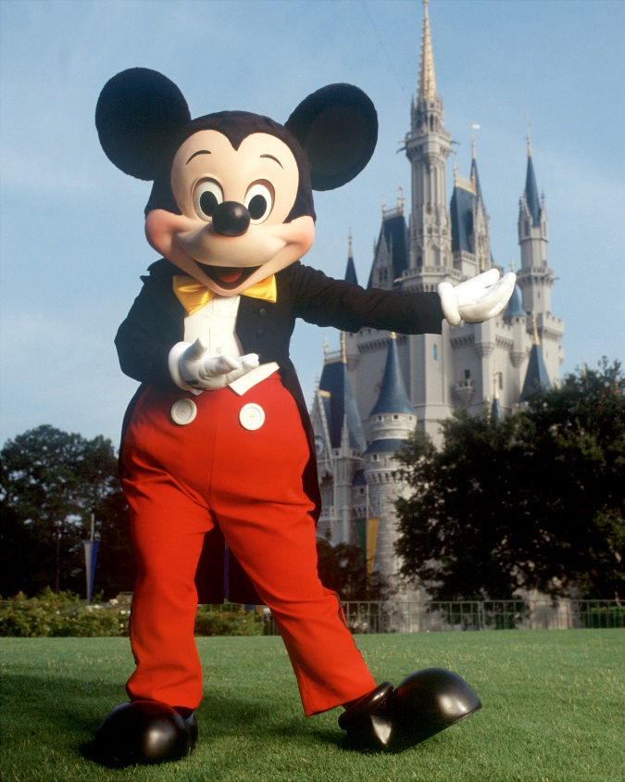

Slide 13
Every Christian is a saint
Every Christian is in the world and in Christ
Every Christian has every spiritual blessing

Slide 14
³ Praise be to the God and Father of our Lord Jesus Christ, who has blessed us in the heavenly realms with every spiritual blessing in Christ. ⁴ For he chose us in him before the creation of the world to be holy and blameless in his sight. In love ⁵ he predestined us to be adopted as his sons through Jesus Christ, in accordance with his pleasure and will— ⁶ to the praise of his glorious grace, which he has freely given us in the One he loves.

Slide 15
Overview of Calvinism
Overview of Arminianism
Overview of Corporate Election

Slide 16
³ Praise be to the God and Father of our Lord Jesus Christ, who has blessed us in the heavenly realms with every spiritual blessing in Christ. ⁴ For he chose us in him before the creation of the world to be holy and blameless in his sight. In love ⁵ he predestined us to be adopted as his sons through Jesus Christ, in accordance with his pleasure and will— ⁶ to the praise of his glorious grace, which he has freely given us in the One he loves.

Slide 17
⁷ In him we have redemption through his blood, the forgiveness of sins, in accordance with the riches of God’s grace ⁸ that he lavished on us with all wisdom and understanding. ⁹ And he made known to us the mystery of his will according to his good pleasure, which he purposed in Christ, ¹⁰ to be put into effect when the times will have reached their fulfillment—to bring all things in heaven and on earth together under one head, even Christ.

Slide 18
¹¹ In him we were also chosen, having been predestined according to the plan of him who works out everything in conformity with the purpose of his will, ¹² in order that we, who were the first to hope in Christ, might be for the praise of his glory. ¹³ And you also were included in Christ when you heard the word of truth, the gospel of your salvation.

Slide 19
“works out” = energountos
to cause to function, to bring about, to result in

Slide 20
¹¹ In him we were also chosen, having been predestined according to the plan of him who works out everything in conformity with the purpose of his will, ¹² in order that we, who were the first to hope in Christ, might be for the praise of his glory. ¹³ And you also were included in Christ when you heard the word of truth, the gospel of your salvation.

Slide 21
Having believed, you were marked in him with a seal, the promised Holy Spirit, ¹⁴ who is a deposit guaranteeing our inheritance until the redemption of those who are God’s possession—to the praise of his glory.

Slide 22
The gospel
Manger Cross Crown

Slide 23
Having believed, you were marked in him with a seal, the promised Holy Spirit, ¹⁴ who is a deposit guaranteeing our inheritance until the redemption of those who are God’s possession—to the praise of his glory.

Slide 24
“Deposit” = arrabon
a down payment that guarantees complete payment

Slide 25
Having believed, you were marked in him with a seal, the promised Holy Spirit, ¹⁴ who is a deposit guaranteeing our inheritance until the redemption of those who are God’s possession—to the praise of his glory.

Slide 26
How do we apply this passage?

Slide 27
1. Get off the throne

Slide 28
1. Get off the throne
2. Worship “Big”

Slide 29
Doxology (“Word of Glory”)
Praise God from whom all blessings flow Praise Him, all creatures here below Praise Him above the Heavenly host Praise Father, Son and Holy.

