Slide 1
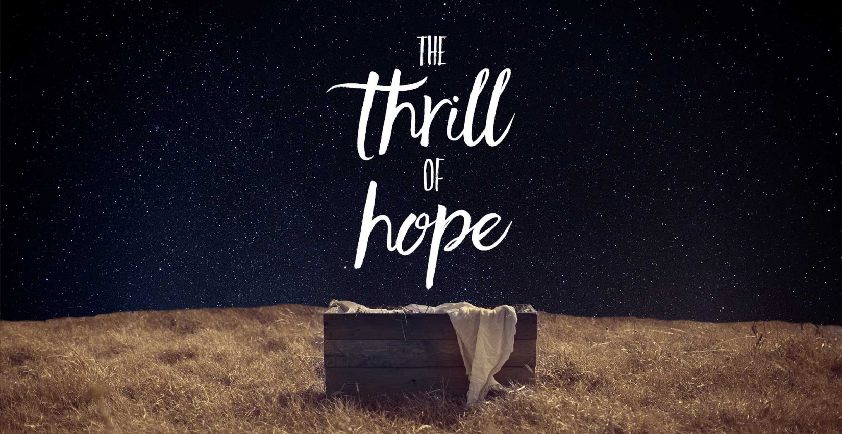

Slide 2
Matthew 2:1-18

Slide 3
¹ After Jesus was born in Bethlehem in Judea, during the time of King Herod, Magi from the east came to Jerusalem ² and asked, “Where is the one who has been born king of the Jews? We saw his star in the east and have come to worship him.” ³ When King Herod heard this he was disturbed, and all Jerusalem with him. ⁴ When he had called together all the people’s chief priests and teachers of the law, he asked them where the Christ was to be born.

Slide 4
⁵ “In Bethlehem in Judea,” they replied, “for this is what the prophet has written: ⁶ “ ‘But you, Bethlehem, in the land of Judah, are by no means least among the rulers of Judah; for out of you will come a ruler who will be the shepherd of my people Israel.’” ⁷ Then Herod called the Magi secretly and found out from them the exact time the star had appeared. ⁸ He sent them to Bethlehem and said, “Go and make a careful search for the child.

Slide 5
As soon as you find him, report to me, so that I too may go and worship him.” ⁹ After they had heard the king, they went on their way, and the star they had seen in the east went ahead of them until it stopped over the place where the child was. ¹⁰ When they saw the star, they were overjoyed. ¹¹ On coming to the house, they saw the child with his mother Mary, and they bowed down and worshiped him. Then they opened their

Slide 6
treasures and presented him with gifts of gold and of incense and of myrrh. ¹² And having been warned in a dream not to go back to Herod, they returned to their country by another route. ¹³ When they had gone, an angel of the Lord appeared to Joseph in a dream. “Get up,” he said, “take the child and his mother and escape to Egypt. Stay there until I tell you, for Herod is going to search for the child to kill him.” ¹⁴ So he got up, took the child and his

Slide 7
mother during the night and left for Egypt, ¹⁵ where he stayed until the death of Herod. And so was fulfilled what the Lord had said through the prophet: “Out of Egypt I called my son.” ¹⁶ When Herod realized that he had been outwitted by the Magi, he was furious, and he gave orders to kill all the boys in Bethlehem and its vicinity who were two years old and under, in accordance with the time he had learned from the Magi.

Slide 8
¹⁷ Then what was said through the prophet Jeremiah was fulfilled: ¹⁸ “A voice is heard in Ramah, weeping and great mourning, Rachel weeping for her children and refusing to be comforted, because they are no more.”

Slide 9
The Shadows Over Christmas

Slide 10
The Shadows Over the First Christmas

Slide 11
1. Global 2. National 3. Personal

Slide 12
Isaiah 9:2 The people walking in darkness have seen a great light; on those living in the land of deep darkness a light has dawned.

Slide 13
For those in deep darkness…

Slide 14
For those causing darkness…

Slide 15
For those in a good place…

Slide 16
A Christmas call for all of us

