Slide 2
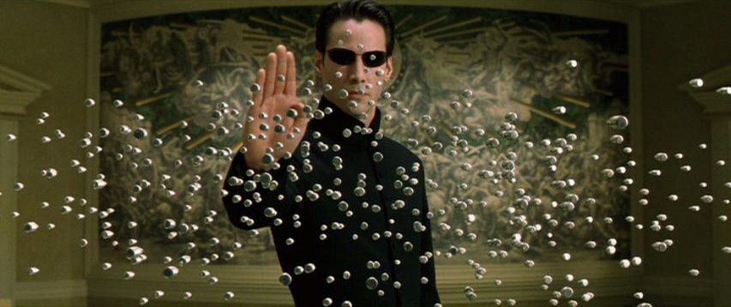

Slide 3
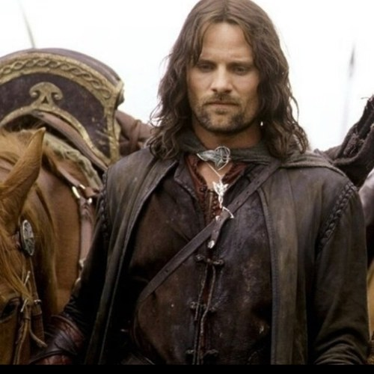

Slide 6
Mark 8:27–30 (NIV)
²⁷ Jesus and his disciples went on to the villages around Caesarea Philippi. On the way he asked them, “Who do people say I am?” ²⁸ They replied, “Some say John the Baptist; others say Elijah; and still others, one of the prophets.” ²⁹ “But what about you?” he asked. “Who do you say I am?” Peter
answered, “You are the Messiah.” ³⁰ Jesus warned them not to tell anyone about him.

Slide 7
“Who do people say
that I am?”
Christology: the study of Jesus Christ—his nature, purpose, etc.

Slide 8
Both then and now…
People had an opinion of Jesus.
Jesus is regarded as someone important.
There are a lot of weird ideas about who Jesus is.

Slide 9
Peter answered, “You are the Messiah.”
christos = “anointed one”
“Christ”/”Messiah”. This term was used in Old Testament times of kings, priests and prophets which were chosen and empowered by God for a particular task.

Slide 10
“What’s the Big Deal?”

Slide 11
1. Christianity rises or falls depending on Jesus’ identity

Slide 12
The Gospel:
Manger + Cross + Crown

Slide 13
2. Identity confers authority

Slide 14
Mark 8:27–30 (NIV)
²⁷ Jesus and his disciples went on to the villages around Caesarea Philippi. On the way he asked them, “Who do people say I am?” ²⁸ They replied, “Some say John the Baptist; others say Elijah; and still others, one of the prophets.” ²⁹ “But what about you?” he asked. “Who do you say I am?” Peter
answered, “You are the Messiah.” ³⁰ Jesus warned them not to tell anyone about him.

