Slide 1
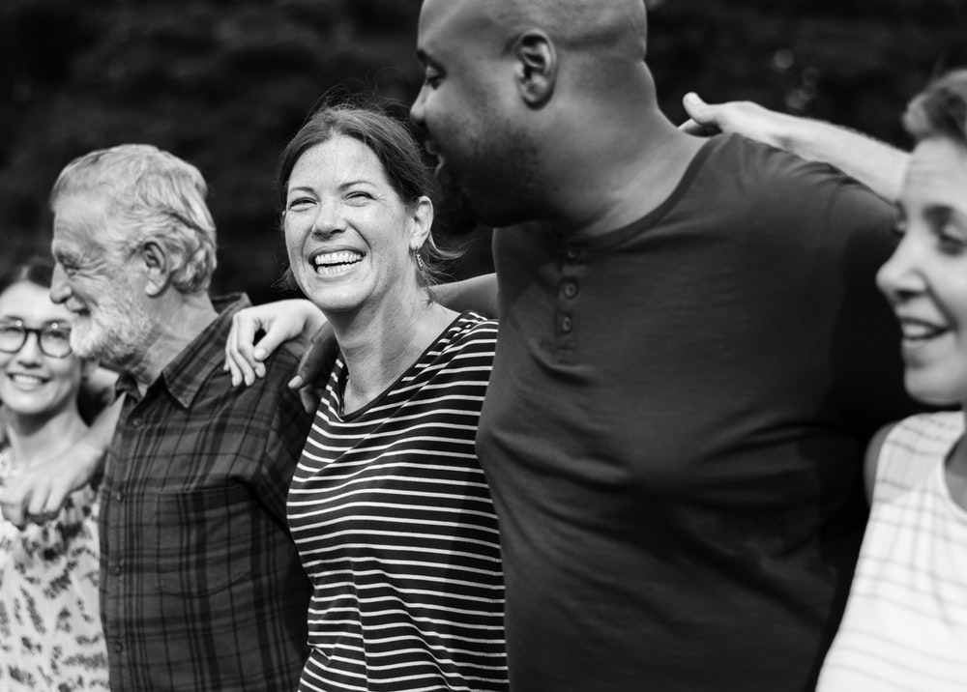
Ephesians
Spirit-filled Marriages

Slide 2
Ephesians 5:21-33
²¹ Submit to one another out of reverence for Christ. ²² Wives, submit to your husbands as to the Lord. ²³ For the husband is the head of the wife as Christ is the head of the church, his body, of which he is the Savior. ²⁴ Now as the church submits to Christ, so also wives should submit to their husbands in everything.

Slide 3
²⁵ Husbands, love your wives, just as Christ loved the church and gave himself up for her ²⁶ to make her holy, cleansing her by the washing with water through the word, ²⁷ and to present her to himself as a radiant church, without stain or wrinkle or any other blemish, but holy and blameless. ²⁸ In this same way, husbands ought to love their wives as their own bodies. He who loves his wife loves himself.

Slide 4
²⁹ After all, no one ever hated his own body, but he feeds and cares for it, just as Christ does the church— ³⁰ for we are members of his body. ³¹ “For this reason a man will leave his father and mother and be united to his wife, and the two will become one flesh.” ³² This is a profound mystery—but I am talking about Christ and the

Slide 5
the church. ³³ However, each one of you also must love his wife as he loves himself, and the wife must respect her husband.

Slide 6
Ephesians
How to thrive in
spiritually-mixed marriages

Slide 7
A “spiritually mixed marriage” can take three forms:
A Christian is married to an unbeliever.
A Christian is married to a spouse who has abandoned their faith in significant ways.
Two married Christians who are on totally different pages regarding their faith.

Slide 8
Don’t leave.
Seek the peace and prosperity of your marriage.
Follow Jesus and Shine!

Slide 9
1 Corinthians 7:12–16
12 To the rest I say this (I, not the Lord): If any brother has a wife who is not a believer and she is willing to live with him, he must not divorce her. 13 And if a woman has a husband who is not a believer and he is willing to live with her, she must not divorce him. 14 For the unbelieving husband has been sanctified

Slide 10
through his wife, and the unbelieving wife has been sanctified through her believing husband. Otherwise your children would be unclean, but as it is, they are holy. 15 But if the unbeliever leaves, let it be so. The brother or the sister is not bound in such circumstances; God has called us to live in peace. 16 How do you know, wife, whether you will save your husband? Or, how do you know, husband, whether you will save your wife?

Slide 11
1. Don’t leave (v. 12-14)

Slide 12
14 For the unbelieving husband has been sanctified through his wife, and the unbelieving wife has been sanctified through her believing husband. Otherwise your children would be unclean, but as it is, they are holy.

Slide 13
through his wife, and the unbelieving wife has been sanctified through her believing husband. Otherwise your children would be unclean, but as it is, they are holy. 15 . ¹⁵ But if the unbeliever leaves, let it be so. The brother or the sister is not bound in such circumstances; God has called us to live in peace. 16 How do you know, wife, whether you will save your husband? Or, how do you know, husband, whether you will save your wife?

Slide 14
2. Seek the peace and prosperity
of your marriage (v. 15)

Slide 15
Your purpose in a spiritually-mixed marriage is to attract your spouse to a relationship with the Lord.

Slide 16
3. Follow Jesus and Shine! (v. 15-16)

Slide 18
Don’t leave.
Seek the peace and prosperity of your marriage.
Follow Jesus and Shine!

