Slide 1
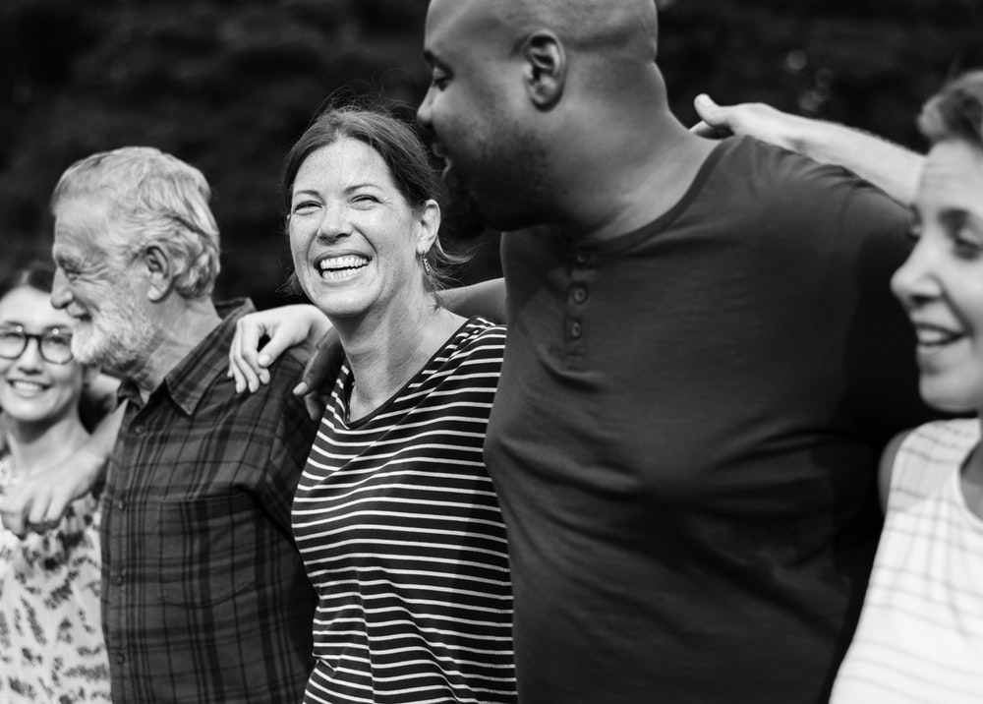
Ephesians
Spirit-filled Marriages

Slide 2
Ephesians 5:15–6:9
¹⁵ Be very careful, then, how you live—not as unwise but as wise, ¹⁶ making the most of every opportunity, because the days are evil. ¹⁷ Therefore do not be foolish, but understand what the Lord’s will is. ¹⁸ Do not get drunk on wine, which leads to debauchery. Instead, be filled with the Spirit.

Slide 3
¹⁹ Speak to one another with psalms, hymns and spiritual songs. Sing and make music in your heart to the Lord, ²⁰ always giving thanks to God the Father for everything, in the name of our Lord Jesus Christ. ²¹ Submit to one another out of reverence for Christ. ²² Wives, submit to your husbands as to the Lord.

Slide 4
²³ For the husband is the head of the wife as Christ is the head of the church, his body, of which he is the Savior. ²⁴ Now as the church submits to Christ, so also wives should submit to their husbands in everything. ²⁵ Husbands, love your wives, just as Christ loved the church and gave himself up for her ²⁶ to make her holy,

Slide 5
cleansing her by the washing with water through the word, ²⁷ and to present her to himself as a radiant church, without stain or wrinkle or any other blemish, but holy and blameless. ²⁸ In this same way, husbands ought to love their wives as their own bodies. He who loves his wife loves himself.

Slide 6
²⁹ After all, no one ever hated his own body, but he feeds and cares for it, just as Christ does the church— ³⁰ for we are members of his body. ³¹ “For this reason a man will leave his father and mother and be united to his wife, and the two will become one flesh.” ³² This is a profound mystery—but I am talking about Christ and the

Slide 7
the church. ³³ However, each one of you also must love his wife as he loves himself, and the wife must respect her husband. ¹ Children, obey your parents in the Lord, for this is right. ² “Honor your father and mother”—which is the first commandment with a promise— ³ “that it may go well with you and that you may enjoy

Slide 8
long life on the earth.” ⁴ Fathers, do not exasperate your children; instead, bring them up in the training and instruction of the Lord. ⁵ Slaves, obey your earthly masters with respect and fear, and with sincerity of heart, just as you would obey Christ. ⁶ Obey them not only to win their favor when their eye is on you, but like

Slide 9
of Christ, doing the will of God from your heart. ⁷ Serve wholeheartedly, as if you were serving the Lord, not men, ⁸ because you know that the Lord will reward everyone for whatever good he does, whether he is slave or free. ⁹ And masters, treat your slaves in the same way. Do not threaten them, since you know that he who is both their Master and yours is in heaven, and there is no favoritism with him.

Slide 10
of Christ, doing the will of God from your heart. ⁷ Serve wholeheartedly, as if you were serving the Lord, not men, ⁸ because you know that the Lord will reward everyone for whatever good he does, whether he is slave or free. ⁹ And masters, treat your slaves in the same way. Do not threaten them, since you know that he who is both their Master and yours is in heaven, and there is no favoritism with him.

Slide 12
1 Corinthians 1:27
But God chose the foolish things of the world to shame the wise; God chose the weak things of the world to shame the strong.

Slide 13
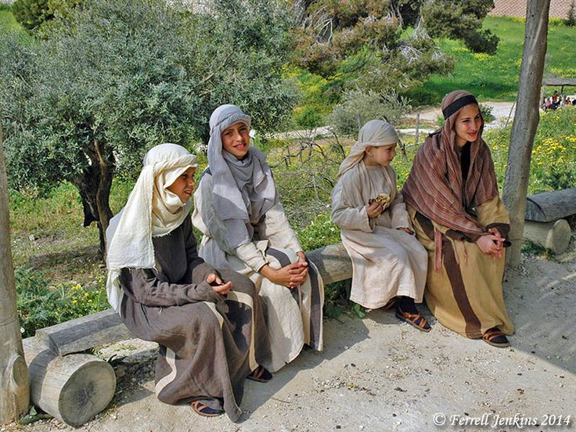

Slide 14
Christians utterly rejected infanticide.
Christianity offered women unparalleled intellectual opportunities.
Christian husbands were commanded to take Jesus’ love for the church as their model for loving their wives and families.
Christianity empowered women NOT to marry.

Slide 15
1 Corinthians 7:8–9
⁸ Now to the unmarried and the widows I say: It is good for them to stay unmarried, as I do. ⁹ But if they cannot control themselves, they should marry, for it is better to marry than to burn with passion.

Slide 16
1 Corinthians 7:25–40

Slide 18
“Does it matter what form Christian marriages take?”

Slide 19
²³ For the husband is the head of the wife as Christ is the head of the church, his body, of which he is the Savior. ²⁴ Now as the church submits to Christ, so also wives should submit to their husbands in everything. ²⁵ Husbands, love your wives, just as Christ loved the church and gave himself up for her ²⁶ to make her holy,

Slide 20
“Does it matter what form Christian marriages take?”
Yes! (Complementarian view)

Slide 21
A. Creation
Male and female were created by God equal in dignity, but distinct in roles within marriage.
B. Fall
Sin introduced a disruption in the proper role-relations between man and woman. Mutual enmity now results.
C. Redemption
Redeemed in Christ, men and women are now able to resume the God-given roles within marriage that God intended; wives submitting, and husbands leading through servant leadership.

Slide 22
“Does it matter what form Christian marriages take?”
No! (Egalitarian view)

Slide 23
A. Creation
Both are equally made in His image (i.e., ontological equality), and both are given the responsibility to rule over His creation (i.e., functional equality).
B. Fall
Sin introduced an illegitimate hierarchy in the relationship between woman and man.
C. Redemption
In Christ full male/female equality is restored. Dignity is given back to women, and servant attitudes are called for in men and women alike.

Slide 24
My/Our View:
Egalitarianism

Slide 25
My encouragement before, during, and after marriage.

Slide 26
Grapple with the texts.
Examine your scripts.
Evaluate your SHAPEs.
Focus on mutual submission.
Agree on a vision – you have freedom in Christ!

