Slide 2
Mark 7:31-37

Slide 3
³¹ Then Jesus left the vicinity of Tyre and went through Sidon, down to the Sea of Galilee and into the region of the Decapolis. ³² There some people brought to him a man who was deaf and could hardly talk, and they begged him to place his hand on the man. ³³ After he took him aside, away from the crowd, Jesus put his fingers into the man’s ears. Then he spit and touched the man’s tongue.

Slide 4
³⁴ He looked up to heaven and with a deep sigh said to him, “Ephphatha!” (which means, “Be opened!”). ³⁵ At this, the man’s ears were opened, his tongue was loosened and he began to speak plainly. ³⁶ Jesus commanded them not to tell anyone. But the more he did so, the more they kept talking about it. ³⁷ People were overwhelmed with amazement. “He has done everything well,” they said. “He even makes the deaf hear and the mute speak.”

Slide 5
³¹ Then Jesus left the vicinity of Tyre and went through Sidon, down to the Sea of Galilee and into the region of the Decapolis. ³² There some people brought to him a man who was deaf and could hardly talk, and they begged him to place his hand on the man. ³³ After he took him aside, away from the crowd, Jesus put his fingers into the man’s ears. Then he spit and touched the man’s tongue.

Slide 6
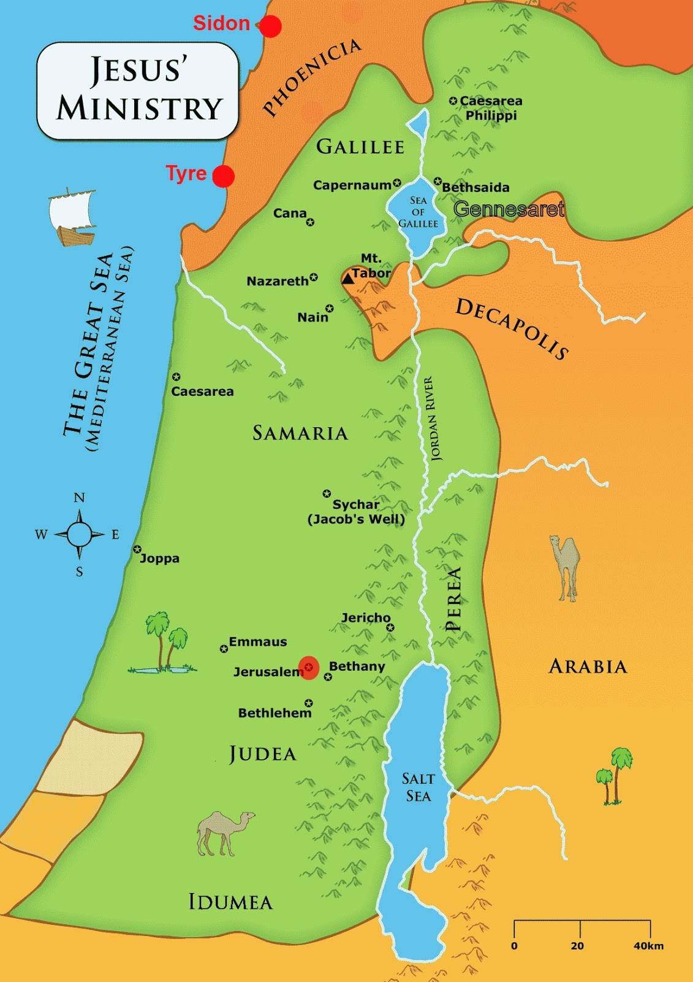

Slide 7
v. 31 Jesus sends his disciples into non-believing territory.
Following Jesus means taking risks.

Slide 8
³¹ Then Jesus left the vicinity of Tyre and went through Sidon, down to the Sea of Galilee and into the region of the Decapolis. ³² There some people brought to him a man who was deaf and could hardly talk, and they begged him to place his hand on the man. ³³ After he took him aside, away from the crowd, Jesus put his fingers into the man’s ears. Then he spit and touched the man’s tongue.

Slide 9
v. 32 We tend to only want to help people who “deserve it.”
Jesus doesn’t heal, bless, engage, or help people based on this criteria.

Slide 10
“could hardly talk” = mogilalos
(Isaiah 35:1-6)

Slide 11
³¹ Then Jesus left the vicinity of Tyre and went through Sidon, down to the Sea of Galilee and into the region of the Decapolis. ³² There some people brought to him a man who was deaf and could hardly talk, and they begged him to place his hand on the man. ³³ After he took him aside, away from the crowd, Jesus put his fingers into the man’s ears. Then he spit and touched the man’s tongue.

Slide 12
v. 33 Jesus took the man aside in order to personally connect with him.

Slide 13
v. 33-34 Jesus condescends in order to transform this man’s life.

Slide 14
³⁴ He looked up to heaven and with a deep sigh said to him, “Ephphatha!” (which means, “Be opened!”). ³⁵ At this, the man’s ears were opened, his tongue was loosened and he began to speak plainly. ³⁶ Jesus commanded them not to tell anyone. But the more he did so, the more they kept talking about it. ³⁷ People were overwhelmed with amazement. “He has done everything well,” they said. “He even makes the deaf hear and the mute speak.”

Slide 15
v. 36 Jesus doesn’t want people seeking him for his miracles, but his message.

Slide 16
³⁴ He looked up to heaven and with a deep sigh said to him, “Ephphatha!” (which means, “Be opened!”). ³⁵ At this, the man’s ears were opened, his tongue was loosened and he began to speak plainly. ³⁶ Jesus commanded them not to tell anyone. But the more he did so, the more they kept talking about it. ³⁷ People were overwhelmed with amazement. “He has done everything well,” they said. “He even makes the deaf hear and the mute speak.”

Slide 17
“He does all things well.”

