Slide 1
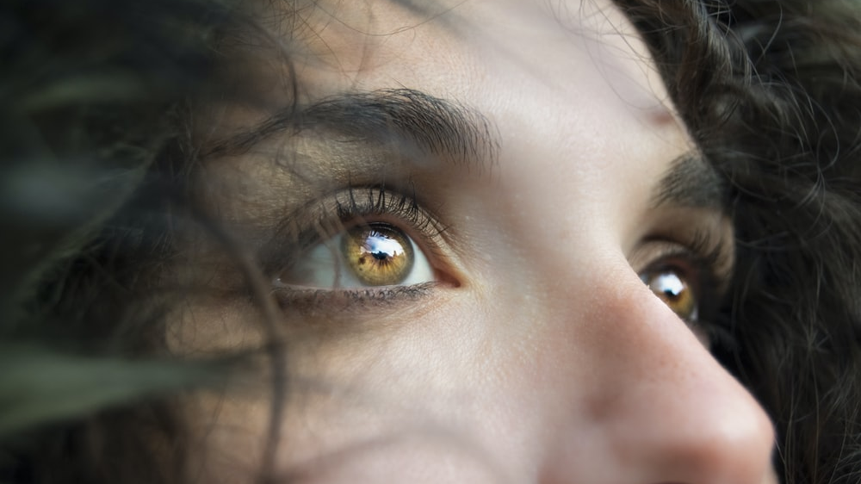

Slide 2
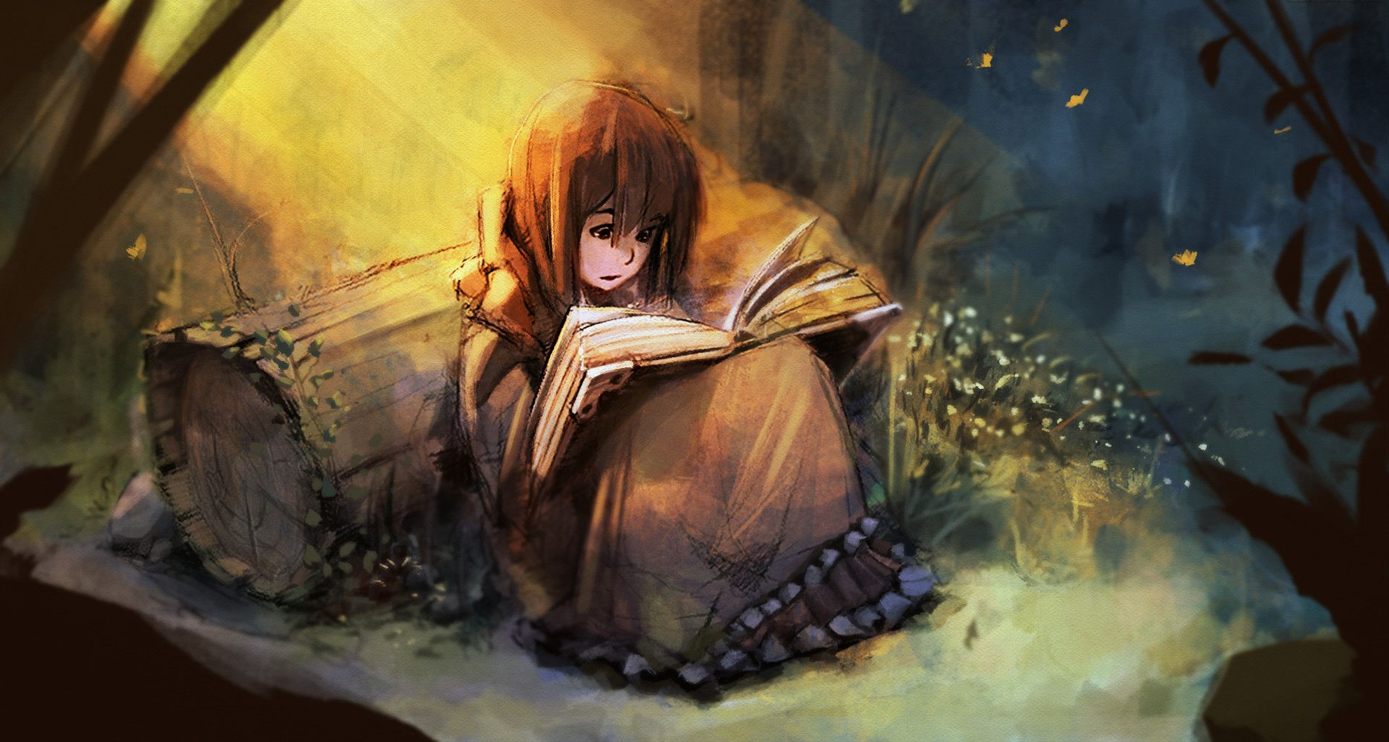

Slide 3
“Humans are storytelling animals. We thrill to an astonishing multitude of fictions on pages, on stages, and on screens: murder stories, sex stories, war stories, conspiracy stories, true stories and false. We are, as a species, addicted to story. But the addiction runs deeper than we think. We can walk away from our books and our screens, but we can never walk away from story. For humans, story is like gravity: an inescapable field of force that influences everything, but is so omnipresent that we hardly notice it.”
Jonathan Gottschall Ph.D.

Slide 4
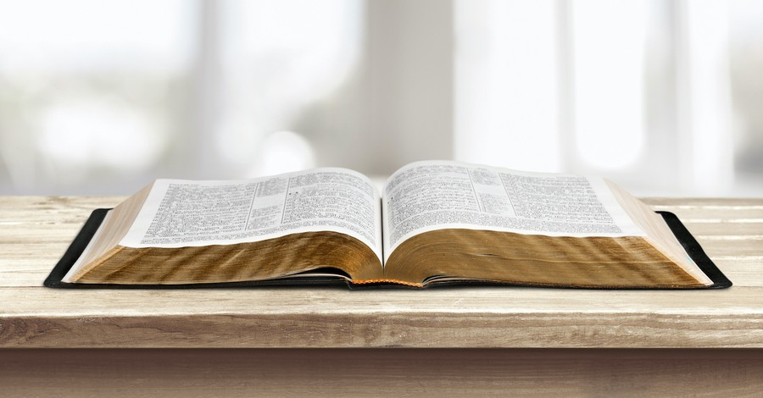

Slide 5
Creation
Fall
Redemption
Glorification

Slide 6
1-3: Messages to the 7 Churches (present reality)
4-5: Vision of Heavenly Throne room
6-8: 7 Seals
8b-11: 7 Trumpets
12-14: Series of Visions/”Signs”
15-16: 7 Bowls
17-19a: Fall of Babylon
19a-20: The Final Battle and 1000 Year Reign
21-22: New Heavens and New Earth!
Chapter 12: Spiritual war (heavenly perspective)
Chapter 13: Spiritual War (earthly perspective)
Chapter 14: Judgement and Glorification

Slide 7
¹ Then I looked, and there was the Lamb, standing on Mount Zion, and with him were 144,000 who had his name and his Father’s name written on their foreheads. ² I heard a sound from heaven like the sound of cascading waters and like the rumbling of loud thunder. The sound I heard was like harpists playing on their harps. ³ They sang a new song before the throne and before the four living creatures and the elders, but no one could learn the song except the 144,000 who had been redeemed from the earth. ⁴ These are the ones who have not defiled themselves with women, since they remained virgins. These are the ones who follow the Lamb wherever he goes. They were redeemed from humanity as the firstfruits for God and the Lamb. ⁵ No lie was found in their mouths; they are blameless.

Slide 8
⁶ Then I saw another angel flying high overhead, with the eternal gospel to announce to the inhabitants of the earth—to every nation, tribe, language, and people. ⁷ He spoke with a loud voice: “Fear God and give him glory, because the hour of his judgment has come. Worship the one who made heaven and earth, the sea and the springs of water.”
⁸ And another, a second angel, followed, saying, “It has fallen, Babylon the Great has fallen. She made all the nations drink the wine of her sexual immorality, which brings wrath.”
⁹ And another, a third angel, followed them and spoke with a loud

Slide 9
voice: “If anyone worships the beast and its image and receives a mark on his forehead or on his hand, ¹⁰ he will also drink the wine of God’s wrath, which is poured full strength into the cup of his anger. He will be tormented with fire and sulfur in the sight of the holy angels and in the sight of the Lamb, ¹¹ and the smoke of their torment will go up forever and ever. There is no rest, day or night for those who worship the beast and its image, or anyone who receives the mark of its name. ¹² This calls for endurance from the saints, who keep God’s commands and their faith in Jesus.”

Slide 10
¹³ Then I heard a voice from heaven saying, “Write: Blessed are the dead who die in the Lord from now on.”
“Yes,” says the Spirit, “so they will rest from their labors, since their works follow them.”
¹⁴ Then I looked, and there was a white cloud, and one like the Son of Man, was seated on the cloud, with a golden crown on his head and a sharp sickle in his hand. ¹⁵ Another angel came out of the temple, crying out in a loud voice to the one who was seated on the cloud, “Use your sickle and reap, for the time to reap has come, since the harvest of the earth is ripe.” ¹⁶ So the one seated on the cloud swung his sickle over the earth, and the earth was harvested.

Slide 11
¹⁷ Then another angel who also had a sharp sickle came out of the temple in heaven. ¹⁸ Yet another angel, who had authority over fire, came from the altar, and he called with a loud voice to the one who had the sharp sickle, “Use your sharp sickle and gather the clusters of grapes from the vineyard of the earth, because its grapes have ripened.” ¹⁹ So the angel swung his sickle at the earth and gathered the grapes from the vineyard of the earth, and he threw them into the great winepress of God’s wrath. ²⁰ Then the press was trampled outside the city, and blood flowed out of the press up to the horses’ bridles for about 180 miles.,

Slide 12
Preterist: It’s been fulfilled in the past
Historicist: It’s being fulfilled across history
Four Views of How to Read Revelation
Futurist: It will be fulfilled in the future
Idealist: It’s fulfilled in every age

Slide 13
Preterist: Revelation has been fulfilled in the past
The Lamb with the 144,000 is a duplicate scene from chapter 7.
These “first-fruits” are Jewish believers who were killed in the first century.
They were “virgins” in that they didn’t participate with the corrupted Roman or Jewish Temple systems of anti-Christ oppression.
“Babylon has fallen” is a condemnation on the Jewish nation’s corruption.
“Fire and Brimstone” for the Beast’s worshippers is a symbolic sign of impending death and judgement against Jerusalem(Jewish War AD 66-73)
The vision of Christ “on the cloud” depicts judgement action pertaining to the fall of Jerusalem in the first century.

Slide 14
Historicist: It’s being fulfilled across history
The Lamb with the 144,000 is a duplicate scene from chapter 7.
These represent the true Christian church (as opposed to the Roman Catholic church—the beast from the land in chapter 13).
They were “virgins” in that they didn’t participate with the corrupted Roman Catholic false religion.
“Babylon has fallen” is a condemnation on the Roman Catholic church and the Pope.
“Fire and Brimstone” for the Beast’s worshippers is a sign of impending judgement for those who cooperate with the Roman Catholic Church.
The vision of Christ “on the cloud” depicts judgement action pertaining to the final judgement against the enemies of God—including Catholics.

Slide 15
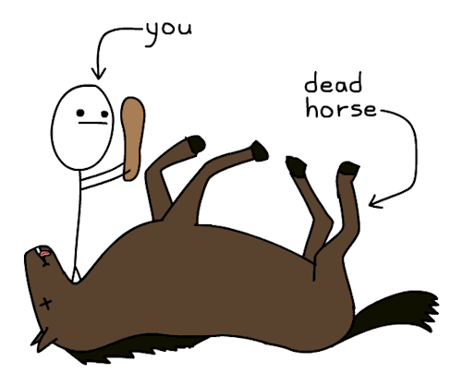

Slide 16
Futurist: It will be fulfilled in the future
The Lamb with the 144,000 is a duplicate scene from chapter 7.
These represent believers who come to Christ during the Great Tribulation.
They were “virgins” in that they didn’t participate with the corrupted anti-Christ system instituted during “the end of days.”
“Babylon has fallen” is a condemnation on the anti-Christ’s regime, and the false church that rises through the false prophet/messiah.
“Fire and Brimstone” for those who worship the beast and his image. Full, unmitigated wrath.
The vision of Christ “on the cloud” depicts judgement against the wicked in the battle of Armageddon.

Slide 17
Idealist: It’s fulfilled in every age
The Lamb with the 144,000 is a duplicate scene from chapter 7.
These represents all believers who bear the mark of Jesus and the Father’s Name instead of the Mark of the Beast.
They were “virgins” in that they didn’t participate with the anti-Christ systems of idolatry.
“Babylon has fallen” is a condemnation of any human societies organized against God. They are coming to an end!
“Fire and Brimstone” is the judgement coming for those who have partnered with anti-Christ systems of power and idolatry.
The vision of Christ “on the cloud” depicts the final judgement at Christ’s coming (cf. 6:12-17; 11:15-18).

Slide 18
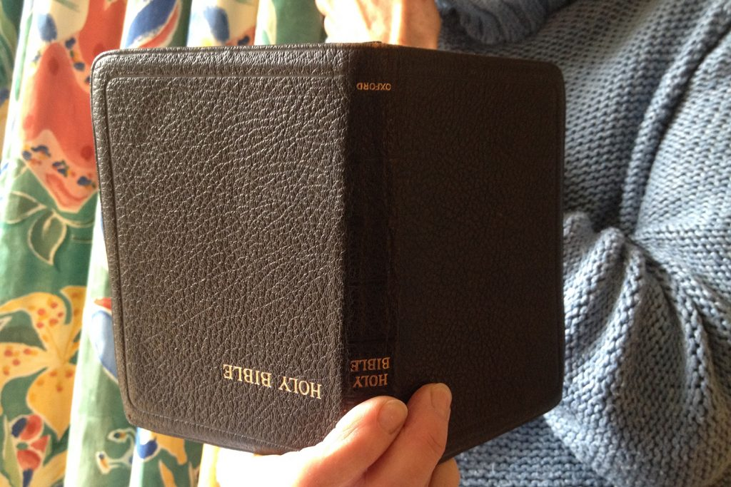

Slide 19
Idealist: It’s fulfilled in every age
Serves as a powerful bridge to discipleship
Look for themes and personal touchpoints
Examples in chapter 14:
Christ’s rule and His protection of the redeemed (cf. 12-13)
Lives that sing a “new song” of praise (v. 2-3)
Christianity as active allegiance to Jesus (“they follow the Lamb wherever he goes”) vs. “easy believism”
The dangers of becoming “drunk” on hedonism (v. 8)
On the terrible reality of Jesus’ Final Judgement against those who resist mercy and his rule (v. 9-11)

Slide 20
May you sing a new song of praise to God.
May you follow the Lamb wherever He goes.
May you fear God and give Him glory, worshipping Him who made heaven and earth, and He who is victorious on your behalf.

