Slide 2
“One of the great tragedies in the church in our day is how Revelation has been so narrowly and incorrectly interpreted with an obsessive focus on the future end time, with the result that we have missed the fact that it contains many profound truths and encouragements concerning Christian life and discipleship.”
G.K. Beale, Revelation: A Shorter Commentary

Slide 3
When was the last time you read Revelation as a guide for here-and-now discipleship?

Slide 4
“How now should we live?”

Slide 5
Authorship
Apostle John during reign of Domitian (81-96)

Slide 6
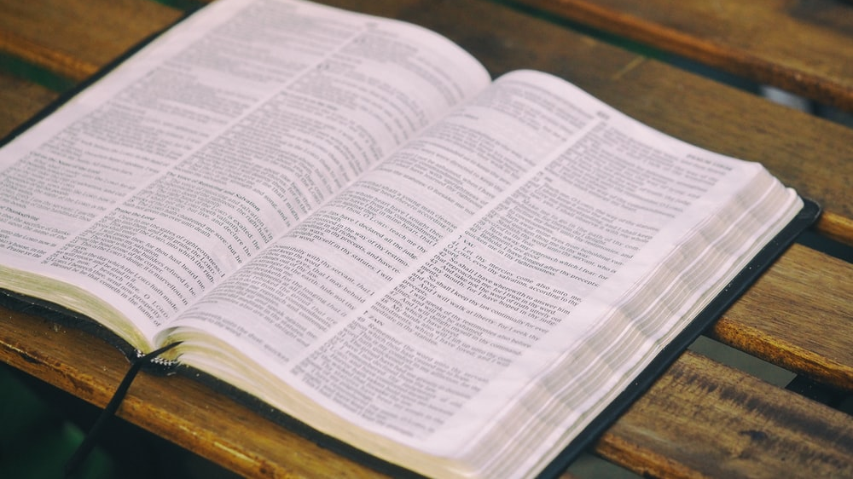
What kind of book is Revelation?

Slide 7
Apocalyptic + Prophetic + Epistle

Slide 8
Apocalyptic + Prophetic + Epistle
Reveals reality
“Behind the Curtain”
“Heavenly Perspective”
Ezekiel
Daniel
Zechariah
“Forth-telling and foretelling”
Letter addressing situations and problems of believers who receive it.

Slide 9
Apocalyptic + Prophetic + Epistle
Reveals reality
“Behind the Curtain”
“Heavenly Perspective”
Ezekiel
Daniel
Zechariah
“Forth-telling and foretelling”
Letter addressing situations and problems of believers who receive it.

Slide 10
It is difficult to understand Revelation without understanding the Old Testament.

Slide 11
278 out of 404 verses contain references to the OT
Over 500 allusions to OT texts are made in total
Daniel/Ezekiel/Zechariah’s themes of Judgment, Tribulation, Idolatry, Divine Protection, Victorious End-Time Battle, Falling Away, Spirit Empowering God’s People, all come together in Revelation

Slide 12
“By far the most important key to understanding John’s vision is understanding the OT. Most people take Revelation as a springboard for looking forward. However, without first looking back to the OT and seeing what it meant in John’s time, and then moving forward from there to the present, we will not properly understand what it has to say about the past, the present, or the future.”
G.K. Beale, Revelation: A Shorter Commentary

Slide 13
Revelation makes known God’s perspective and purposes in history so that believers in Jesus are equipped with a vision for victory and remain faithful!

Slide 14
“The focus on the revelation John received from God is how the church is to conduct itself in the midst of an ungodly world. The heavenly revelation gives an entirely different perspective from that offered by the world. Believers are faced with the choice of lining their lives and conduct up with one perspective or the other, and their eternal destiny depends on that choice.”
G.K. Beale

Slide 15
Chapters 1-3: specific issues within the 7 churches
Chapters 4-21: Discloses the nature of the spiritual battle raging “behind the scenes” and how believers are to respond here and now.

Slide 16
Four Ways of Interpreting Revelation

Slide 17
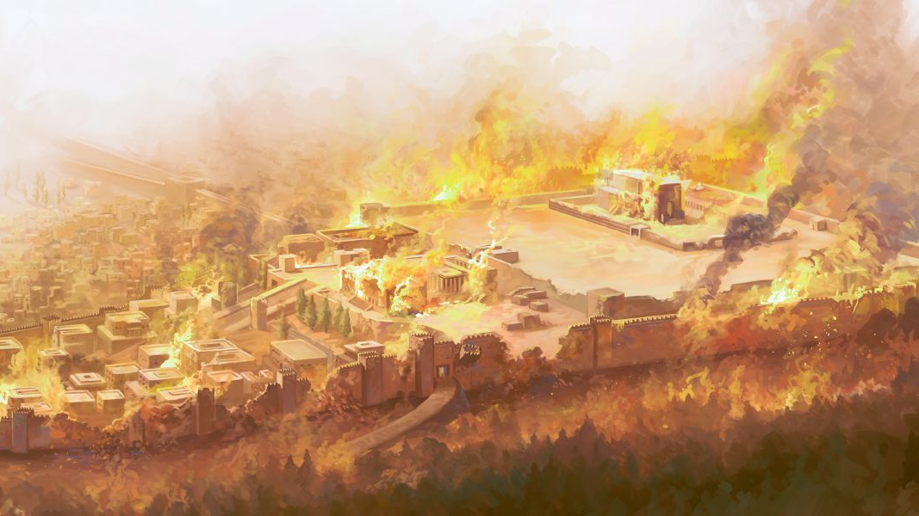
Preterist View

Slide 18
“Preterist” refers to the past
Revelation is a prophecy of the fall of Jerusalem in 70 AD and that everything in the book has already been fulfilled.
Strengths:
This view takes seriously the words used the frame the entire book: “The revelation from Jesus Christ, which God gave him to show his servants what must soon take place.” (Revelation 1:1).
Many of the events of the Jewish War of AD 66-70 find a strong parallel with the events and Judgements depicted in Revelation.
Weaknesses:
Unlikely Revelation was written before AD 70.
In this view Babylon would represents rebellious Israel, but Babylon is never used in ancient Jewish or Christians literature to refer to anything other than Rome.
Daniel says that the end-time judgement is to be universal, not on one nation.
The book would become less and less relevant for anyone living after these events.

Slide 19
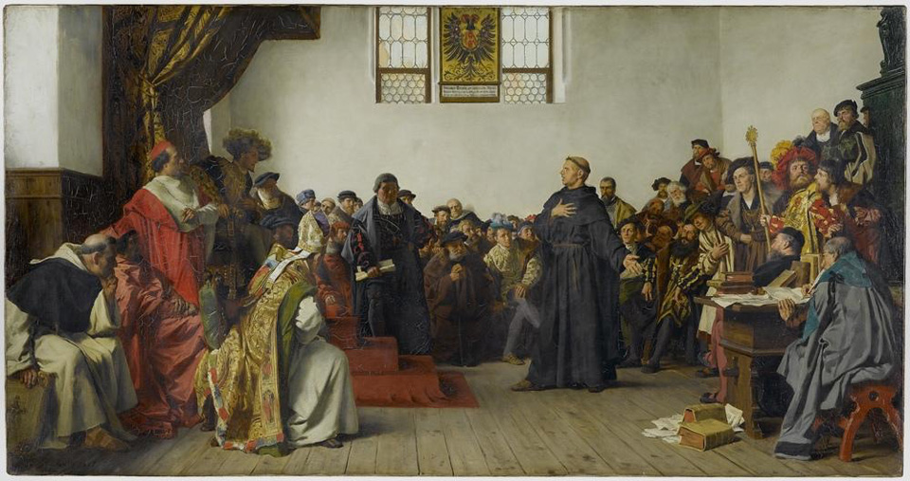
Historicist View

Slide 20
Revelation presents a timeline of major historical events between Pentecost and Jesus’ final return.
The seal, trumpet, and bowl judgements refer to a series of specific historical events such as the collapse of the Roman Empire, corruption of the Roman Catholic church, the Reformation, etc.
Strengths:
Attempts to “stretch” out the relevance of Revelation to all Christians by connecting the prophecies of Revelation with “big” historical events.
Weaknesses:
Each historicist interpreter views the book differently, so as to make the prophecies fit the realities of his or her own age.
“Rorschach” test of biblical interpretation
Uses the cultural moment to interpret the Bible.
Seal, Trumpet, and Bowl judgements are never indicated to be occurring in chronological order and connected to (Western) church history.
If true, Revelation would have little to no significance for those to whom it was originally given.

Slide 21
Futurist View

Slide 22
The Futurist view holds that the entire book, apart from the letters to the churches in chapters 1-3, prophesies events surrounding the return of Christ at the end of history. This view interprets the visions given in chapters 4-21 literally and chronologically. These visions refer to a series of events that will happen in the future in the following order:
the Rapture of the church
the seven-year tribulation
the reign of the antichrist
the nations gather together to wage war against Jerusalem
Christ’s return to defeat the nations
1000 year reign
Satan gathers unbelievers for a final battle (Armeggedon)
Christ defeating Satan and his army, the Final Judgement
Installation of a New Heavens and New Earth.
Strengths: Provides a clear, understandable, and relevant timeline of end-time events that “fits” many pieces of New Testament prophecy and warnings together.

Slide 23
Weaknesses:
Interpreters holding this view are constantly changing their interpretation of historical events to make what is happening currently fit into the pattern
Mark of the Beast = social security number, area codes, credit cards, artificial intelligence, vaccines, etc.
Anti-Christ = Hitler, Stalin, Mikhail Gorbachev, Saddam Hussein, the Pope, Bill Gates, etc.
The Bible is interpreted by modern events first, instead of by itself.
Rapture theology seems to contradict the fundamental message of the book: perseverance under persecution and tribulation.
End-times speculation and anxiety often serves as a distraction from the more pressing priorities of Christian discipleship, growth, maturity, and mission.
This view would mean Revelation was largely irrelevant to any Christians not living in the “last days” and final generation before Jesus’ return.

Slide 24
Spiritual/Idealist View

Slide 25
The Spiritual/Idealist View sees the entire book as a symbolic presentation of the ongoing battle between the kingdom of God and the kingdoms of darkness. The seal, trumpet, and bowl judgements speak to repeated patterns that occur over the course of human history as the kingdom of God gains ground against counterfeit kingdoms. What one reads in Revelation are general patterns rather than specific events.
Strengths:
This view makes imminently relevant the entire book of Revelation, offering Christians in any time and place a powerful vision for victory that is designed to remain faithful in the face of suffering and opposition.
Therefore, Revelation finds fulfillment in countless events throughout the church age.
Elements of the prederist, historicist, and futurist views are incorporated.
It grounds Revelation as an epistle that speaks directly to daily discipleship in the current moment. This is a book that holds relevance and value to all believers at all times and places.
Weaknesses: Critics of the Spiritual/Idealist view are uneasy reading every aspect of the vision as merely symbolic with a direct, precise, or literal reference (i.e. millennial reign of Christ, “666”, etc.)

Slide 26
Four Ways of Interpreting Revelation

Slide 28
This series isn’t about coming to a firm conclusion regarding the right way to interpret Revelation. That is unlikely to happen. But along the way we can learn to avoid seriously wrong ways of interpreting Revelation.
Ideas have consequences!
Iraq war facilitating battle of Armageddon
Vaccines are “Mark of the Beast”
Person “X” is the anti-Christ
End Times as justification to avoid creation care

Slide 29
Revelation makes known God’s perspective and purposes in history so that believers in Jesus are equipped with a vision for victory and remain faithful!

Slide 30
Grace and peace to you from him who is, and who was, and who is to come, and from the seven spirits before his throne, and from Jesus Christ, who is the faithful witness, the first born from the dead, and the rulers of the kings of the earth.
Revelation 1:4-5

