Slide 2
Ephesians 5:1-2

Slide 3
Ephesians 5:1–2
¹ Be imitators of God, therefore, as dearly loved children ² and live a life of love, just as Christ loved us and gave himself up for us as a fragrant offering and sacrifice to God.

Slide 4
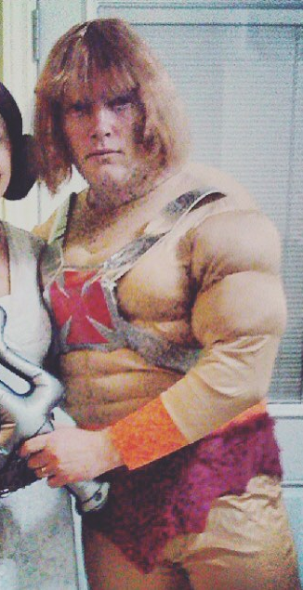
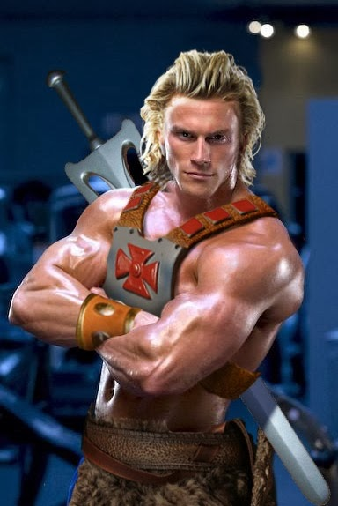

Slide 5
Imitation is the act of taking on the essence of someone or something else.
Mimicry is the act of simulating the appearance of someone or something else.

Slide 6
God
Creation
Others
Self

Slide 7
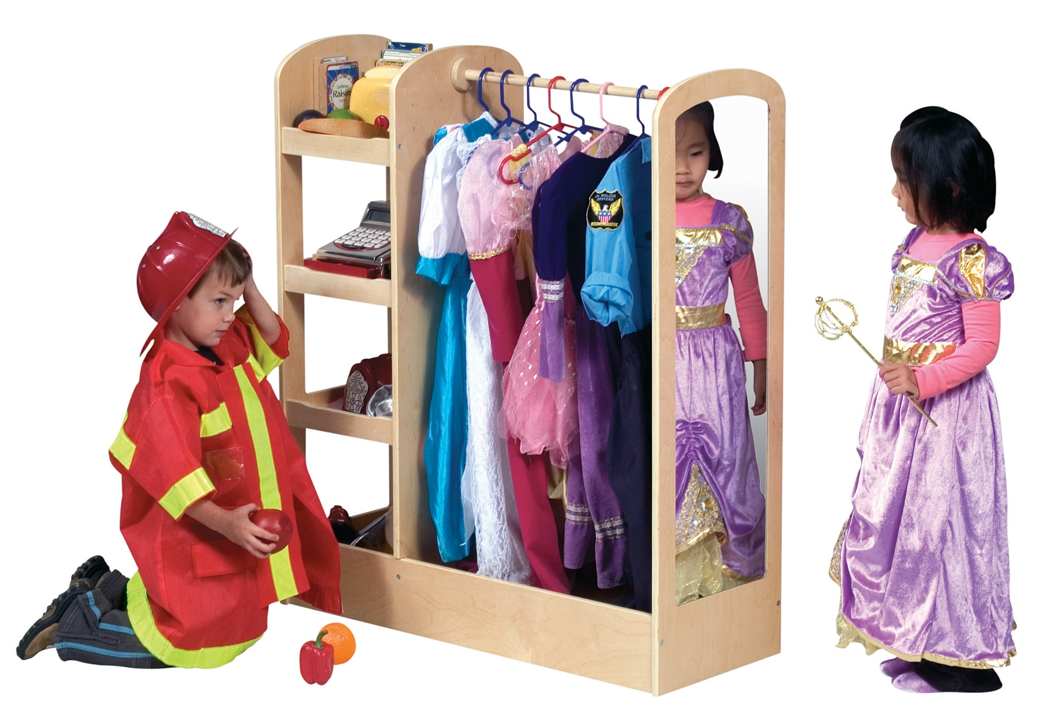

Slide 8
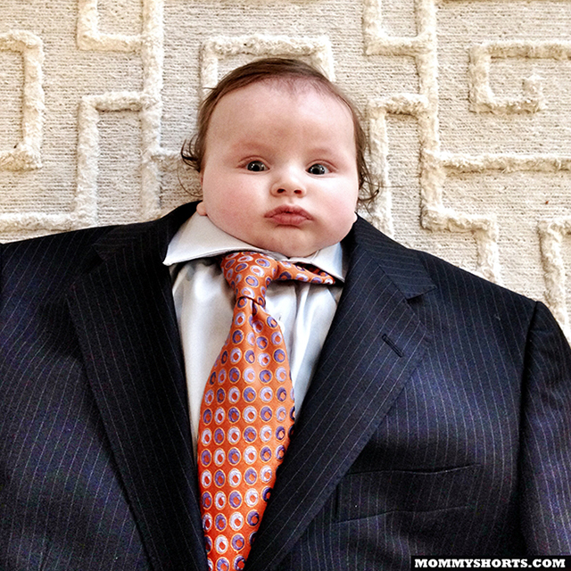

Slide 9
1 Samuel 17:38–39
³⁸ Then Saul dressed David in his own tunic. He put a coat of armor on him and a bronze helmet on his head. ³⁹ David fastened on his sword over the tunic and tried walking around, because he was not used to them. “I cannot go in these,” he said to Saul, “because I am not used to them.” So he took them off.

Slide 10
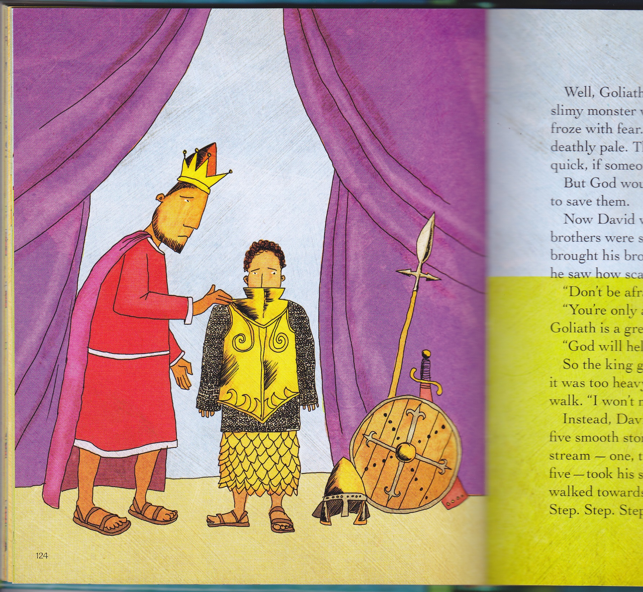

Slide 11
Romans 13:14
¹⁴ Rather, clothe yourselves with the Lord Jesus Christ
Galatians 3:27
²⁷ for all of you who were baptized into Christ have clothed yourselves with Christ.
Colossians 3:12
¹² Therefore, as God’s chosen people, holy and dearly loved, clothe yourselves with compassion, kindness, humility, gentleness and patience.

Slide 12
5 Stages of Change/Transformation
Aware
Ponder
Value
Prioritize
Own It

Slide 13
Sticking Point:
A point, issue, or situation that causes or is likely to cause an impasse.

Slide 14
Exodus 16:1–3
¹ …on the fifteenth day of the second month after they had come out of Egypt. ² In the desert the whole community grumbled against Moses and Aaron. ³ The Israelites said to them, “If only we had died by the Lord’s hand in Egypt! There we sat around pots of meat and ate all the food we wanted, but you have brought us out into this desert to starve this entire assembly to death.”

Slide 15
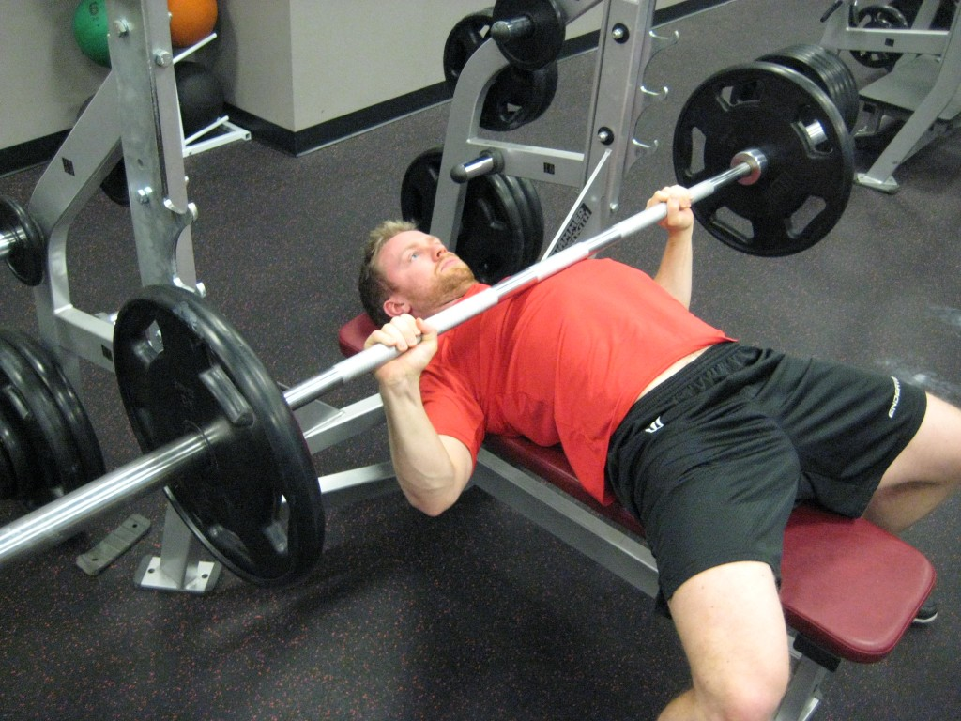

Slide 16
What are the consequences of not pushing through the sticking point?

Slide 17
What is the solution?
How do we learn to imitate and be transformed in Jesus?

Slide 18
Confronting 3 Giants
Busyness
Distraction
Convenience

Slide 19
If we remain busy, distracted, and convenienced, all we will be able to offer God and others is religious mimicry.

Slide 20
Confronting 3 Giants
Busyness
Distraction
Convenience
“No” | Schedule rest
Screen-free hour
Brace for Impact

Slide 21
“Sometimes in these sticking points it's all about finding the passion to push through it.”
Megan Little, V02 Performance Training

