Slide 2
Ephesians 5:1-2

Slide 3
Ephesians 5:1–2
¹ Be imitators of God, therefore, as dearly loved children ² and live a life of love, just as Christ loved us and gave himself up for us as a fragrant offering and sacrifice to God.

Slide 5
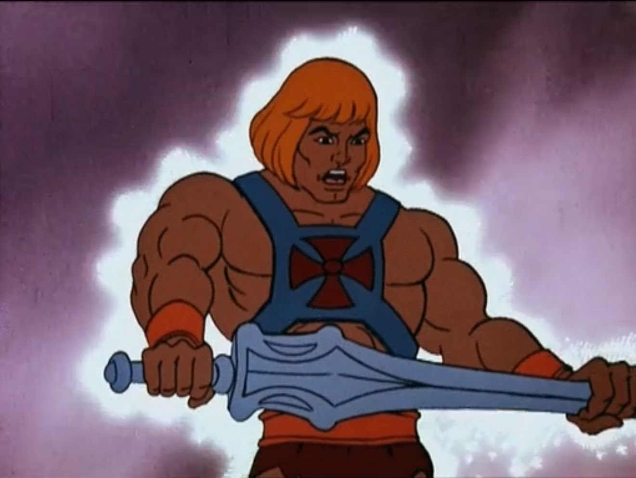

Slide 7
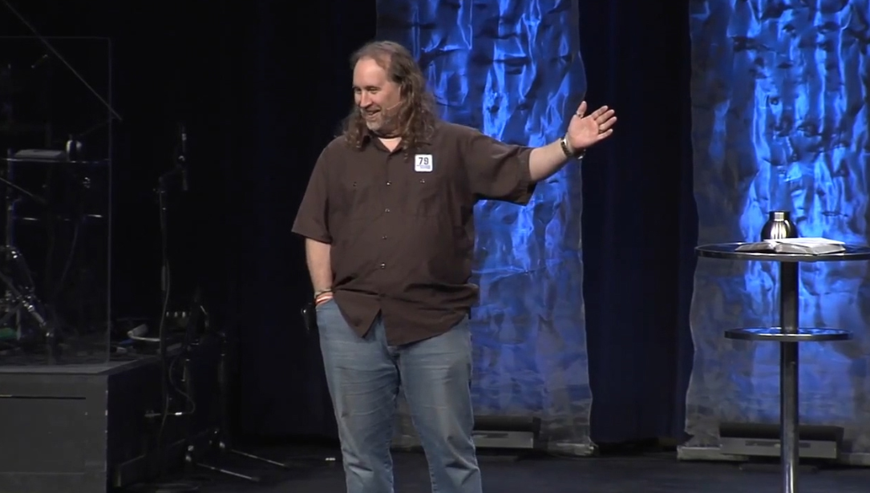

Slide 8
Who have you sought
to imitate?

Slide 9
We admire those who image God in a powerful and compelling way.

Slide 10
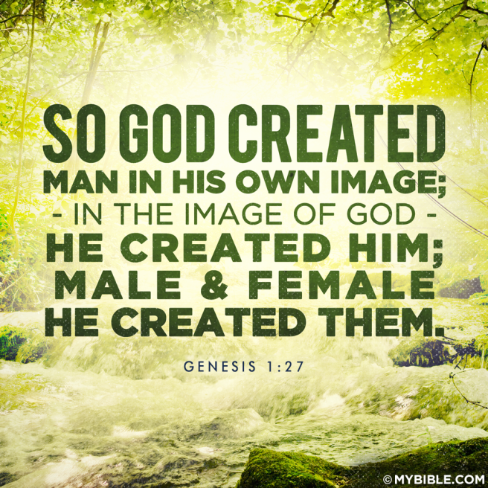

Slide 11
Ephesians 5:1–2
¹ Be imitators of God, therefore, as dearly loved children ² and live a life of love, just as Christ loved us and gave himself up for us as a fragrant offering and sacrifice to God.

Slide 12
1 John 3:16 ¹⁶ This is how we know what love is: Jesus Christ laid down his life for us. And we ought to lay down our lives for our brothers and sisters.

Slide 13
Imitation vs. Mimicry

Slide 14
Imitation is the act of taking on the essence of someone or something else.
Mimicry is the act of simulating the appearance of someone or something else.

Slide 15
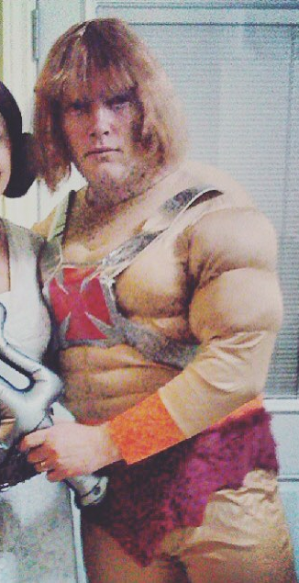
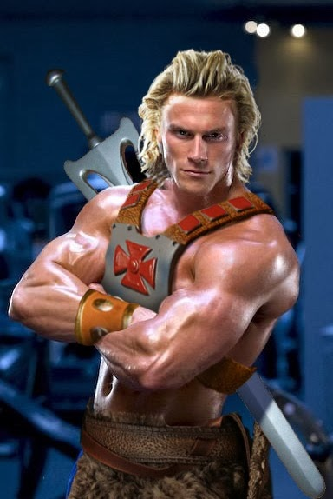

Slide 16
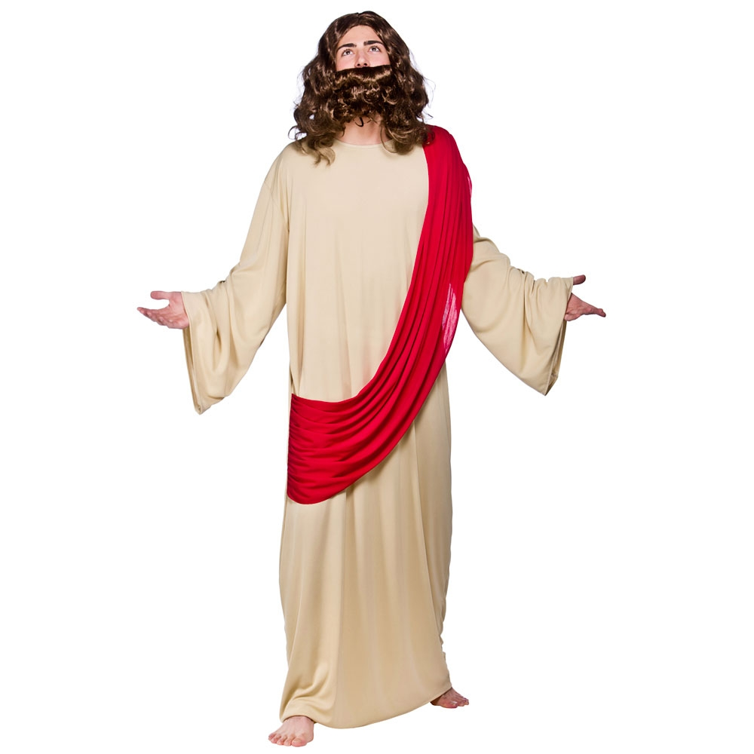

Slide 18
Philippians 3:4–11
If anyone else thinks he has reasons to put confidence in the flesh, I have more: ⁵ circumcised on the eighth day, of the people of Israel, of the tribe of Benjamin, a Hebrew of Hebrews; in regard to the law, a Pharisee; ⁶ as for zeal, persecuting the church; as for legalistic righteousness, faultless. ⁷ But whatever was to my profit I now consider loss for the sake of Christ. ⁸ What is more, I consider everything a loss compared to the surpassing greatness of

Slide 19
knowing Christ Jesus my Lord, for whose sake I have lost all things. I consider them rubbish, that I may gain Christ ⁹ and be found in him, not having a righteousness of my own that comes from the law, but that which is through faith in Christ—the righteousness that comes from God and is by faith. ¹⁰ I want to know Christ and the power of his resurrection and the fellowship of sharing in his sufferings, becoming like him in his death, ¹¹ and so, somehow, to attain to the resurrection from the dead.

Slide 21
Ephesians 5:1–2
¹ Be imitators of God, therefore, as dearly loved children ² and live a life of love, just as Christ loved us and gave himself up for us as a fragrant offering and sacrifice to God.

