Slide 2
Ephesians 4:7-16

Slide 3
⁷ But to each one of us grace has been given as Christ apportioned it. ⁸ This is why it says: “When he ascended on high, he took many captives and gave gifts to his people.” ⁹ (What does “he ascended” mean except that he also descended to the lower, earthly regions? ¹⁰ He who descended is the very one who ascended higher than all the heavens, in order

Slide 4
to fill the whole universe.) ¹¹ So Christ himself gave the apostles, the prophets, the evangelists, the pastors and teachers, ¹² to equip his people for works of service, so that the body of Christ may be built up ¹³ until we all reach unity in the faith and in the knowledge of the Son of God and become mature, attaining to the whole measure of the

Slide 5
fullness of Christ. ¹⁴ Then we will no longer be infants, tossed back and forth by the waves, and blown here and there by every wind of teaching and by the cunning and craftiness of people in their deceitful scheming. ¹⁵ Instead, speaking the truth in love, we will grow to become in every respect the mature body of him who is the

Slide 6
head, that is, Christ. ¹⁶ From him the whole body, joined and held together by every supporting ligament, grows and builds itself up in love, as each part does its work.

Slide 8
⁷ But to each one of us grace has been given as Christ apportioned it. ⁸ This is why it says: “When he ascended on high, he took many captives and gave gifts to his people.” ⁹ (What does “he ascended” mean except that he also descended to the lower, earthly regions? ¹⁰ He who descended is the very one who ascended higher than all the heavens, in order

Slide 9
¹² to equip his people for works of service, so that the body of Christ may be built up ¹³ until we all reach unity in the faith and in the knowledge of the Son of God and become mature, attaining to the whole measure of the fullness of Christ.

Slide 10
What are the Gifts?

Slide 11
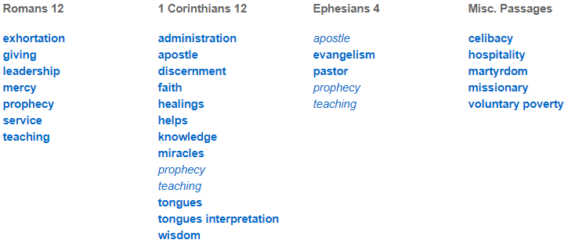

Slide 12
Important Question: Are all of them still active, or were some “founding” gifts that have served their purpose and are no longer given by the Holy Spirit? Which spiritual gifts are for today?

Slide 13
A few preliminary qualifiers.

Slide 14
1. This isn’t a discussion concerning which side believes in the Holy Spirit. Both perspectives value and worship the Spirit, and seek to respond to the Spirit’s leading and guidance.

Slide 15
2. This isn’t a discussion concerning whether or not someone believes in the empowering presence of the Spirit. The question is what does the Spirit empower us for today and how?

Slide 16
3. This isn’t an argument of whether the Holy Spirit gives spiritual gifts to each Christian. The issue is whether the gifts that act as “signs and wonders” are still in operation (or should be!).

Slide 17
4. This isn’t an argument whether God continues to work miraculously and powerfully in people’s lives. It’s whether specific people are gifted in such a way that they can consistently perform the “sign gifts.”

Slide 18
Position #1:
SOME of the gifts are still active and available through the Holy Spirit. “Sign” gifts are not.

Slide 19
Position #2:
ALL the gifts are still active and available through the Holy Spirit.

Slide 20
Where I Stand
Conscious dependence on
the Holy Spirit.

Slide 21
Dangers Within Each View

Slide 22
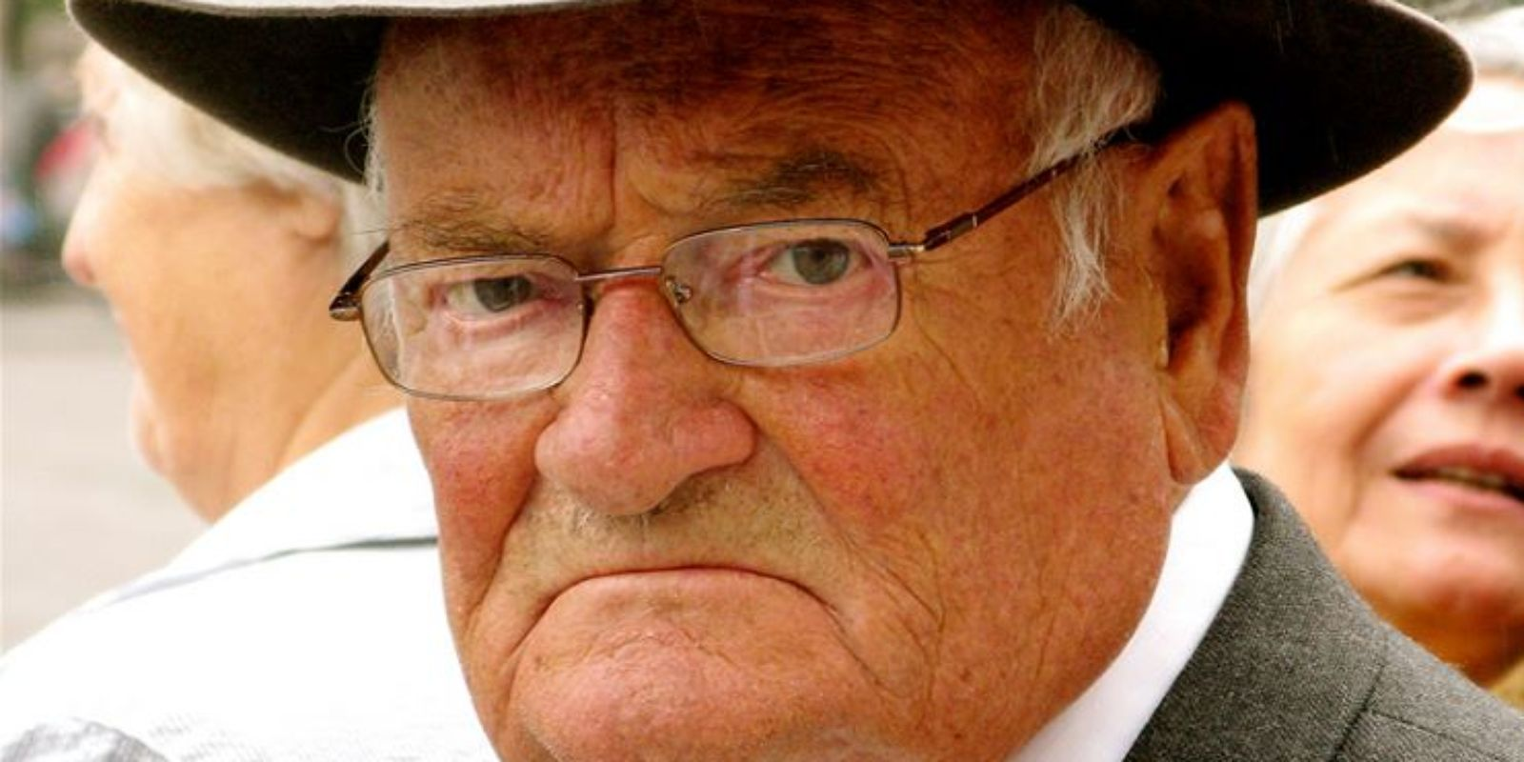
SOME of the Gifts:
Church cultures of dutiful, lifeless observance.

Slide 23
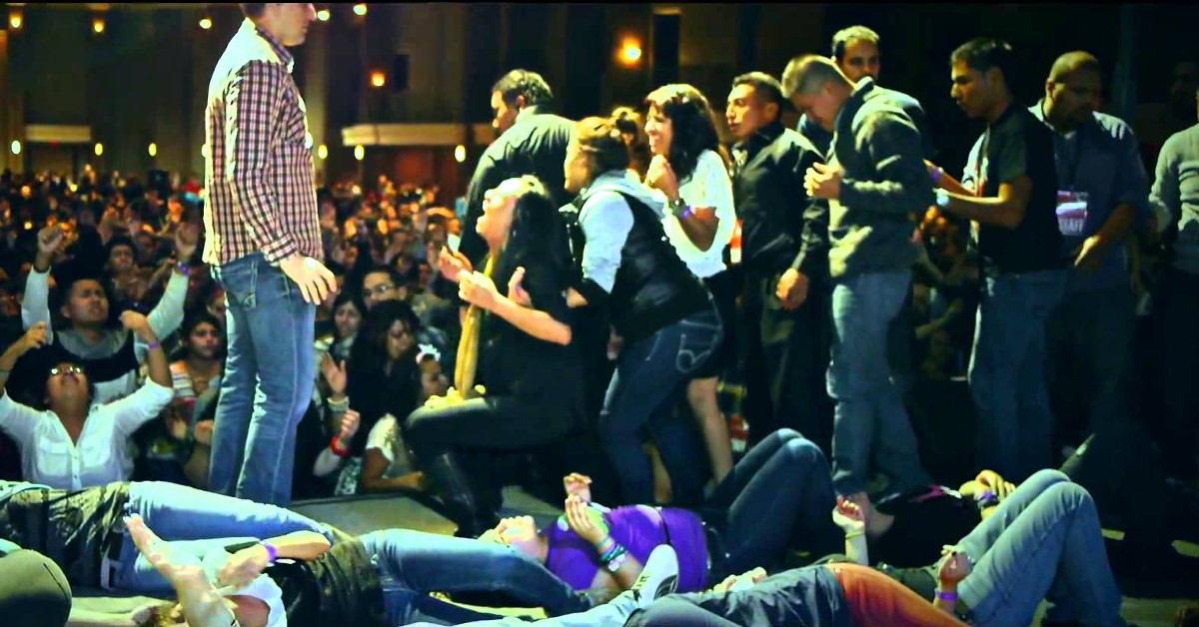
ALL of the Gifts:
Church cultures of “hyper-spirituality” that can be easily exploited by charismatic leaders.

Slide 24
“Does Ephesians 4:11 teach the ‘5-fold ministry’?”

Slide 25
A Spirit-filled Life

Slide 26
I believe a Spirit-filled Christian is one whose life is increasingly conformed to this vision: they passionately love God heart, soul, mind, and strength, and--through the Spirit’s power--love their neighbour as themselves.

