Slide 2
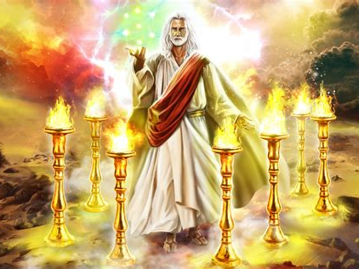

Slide 3
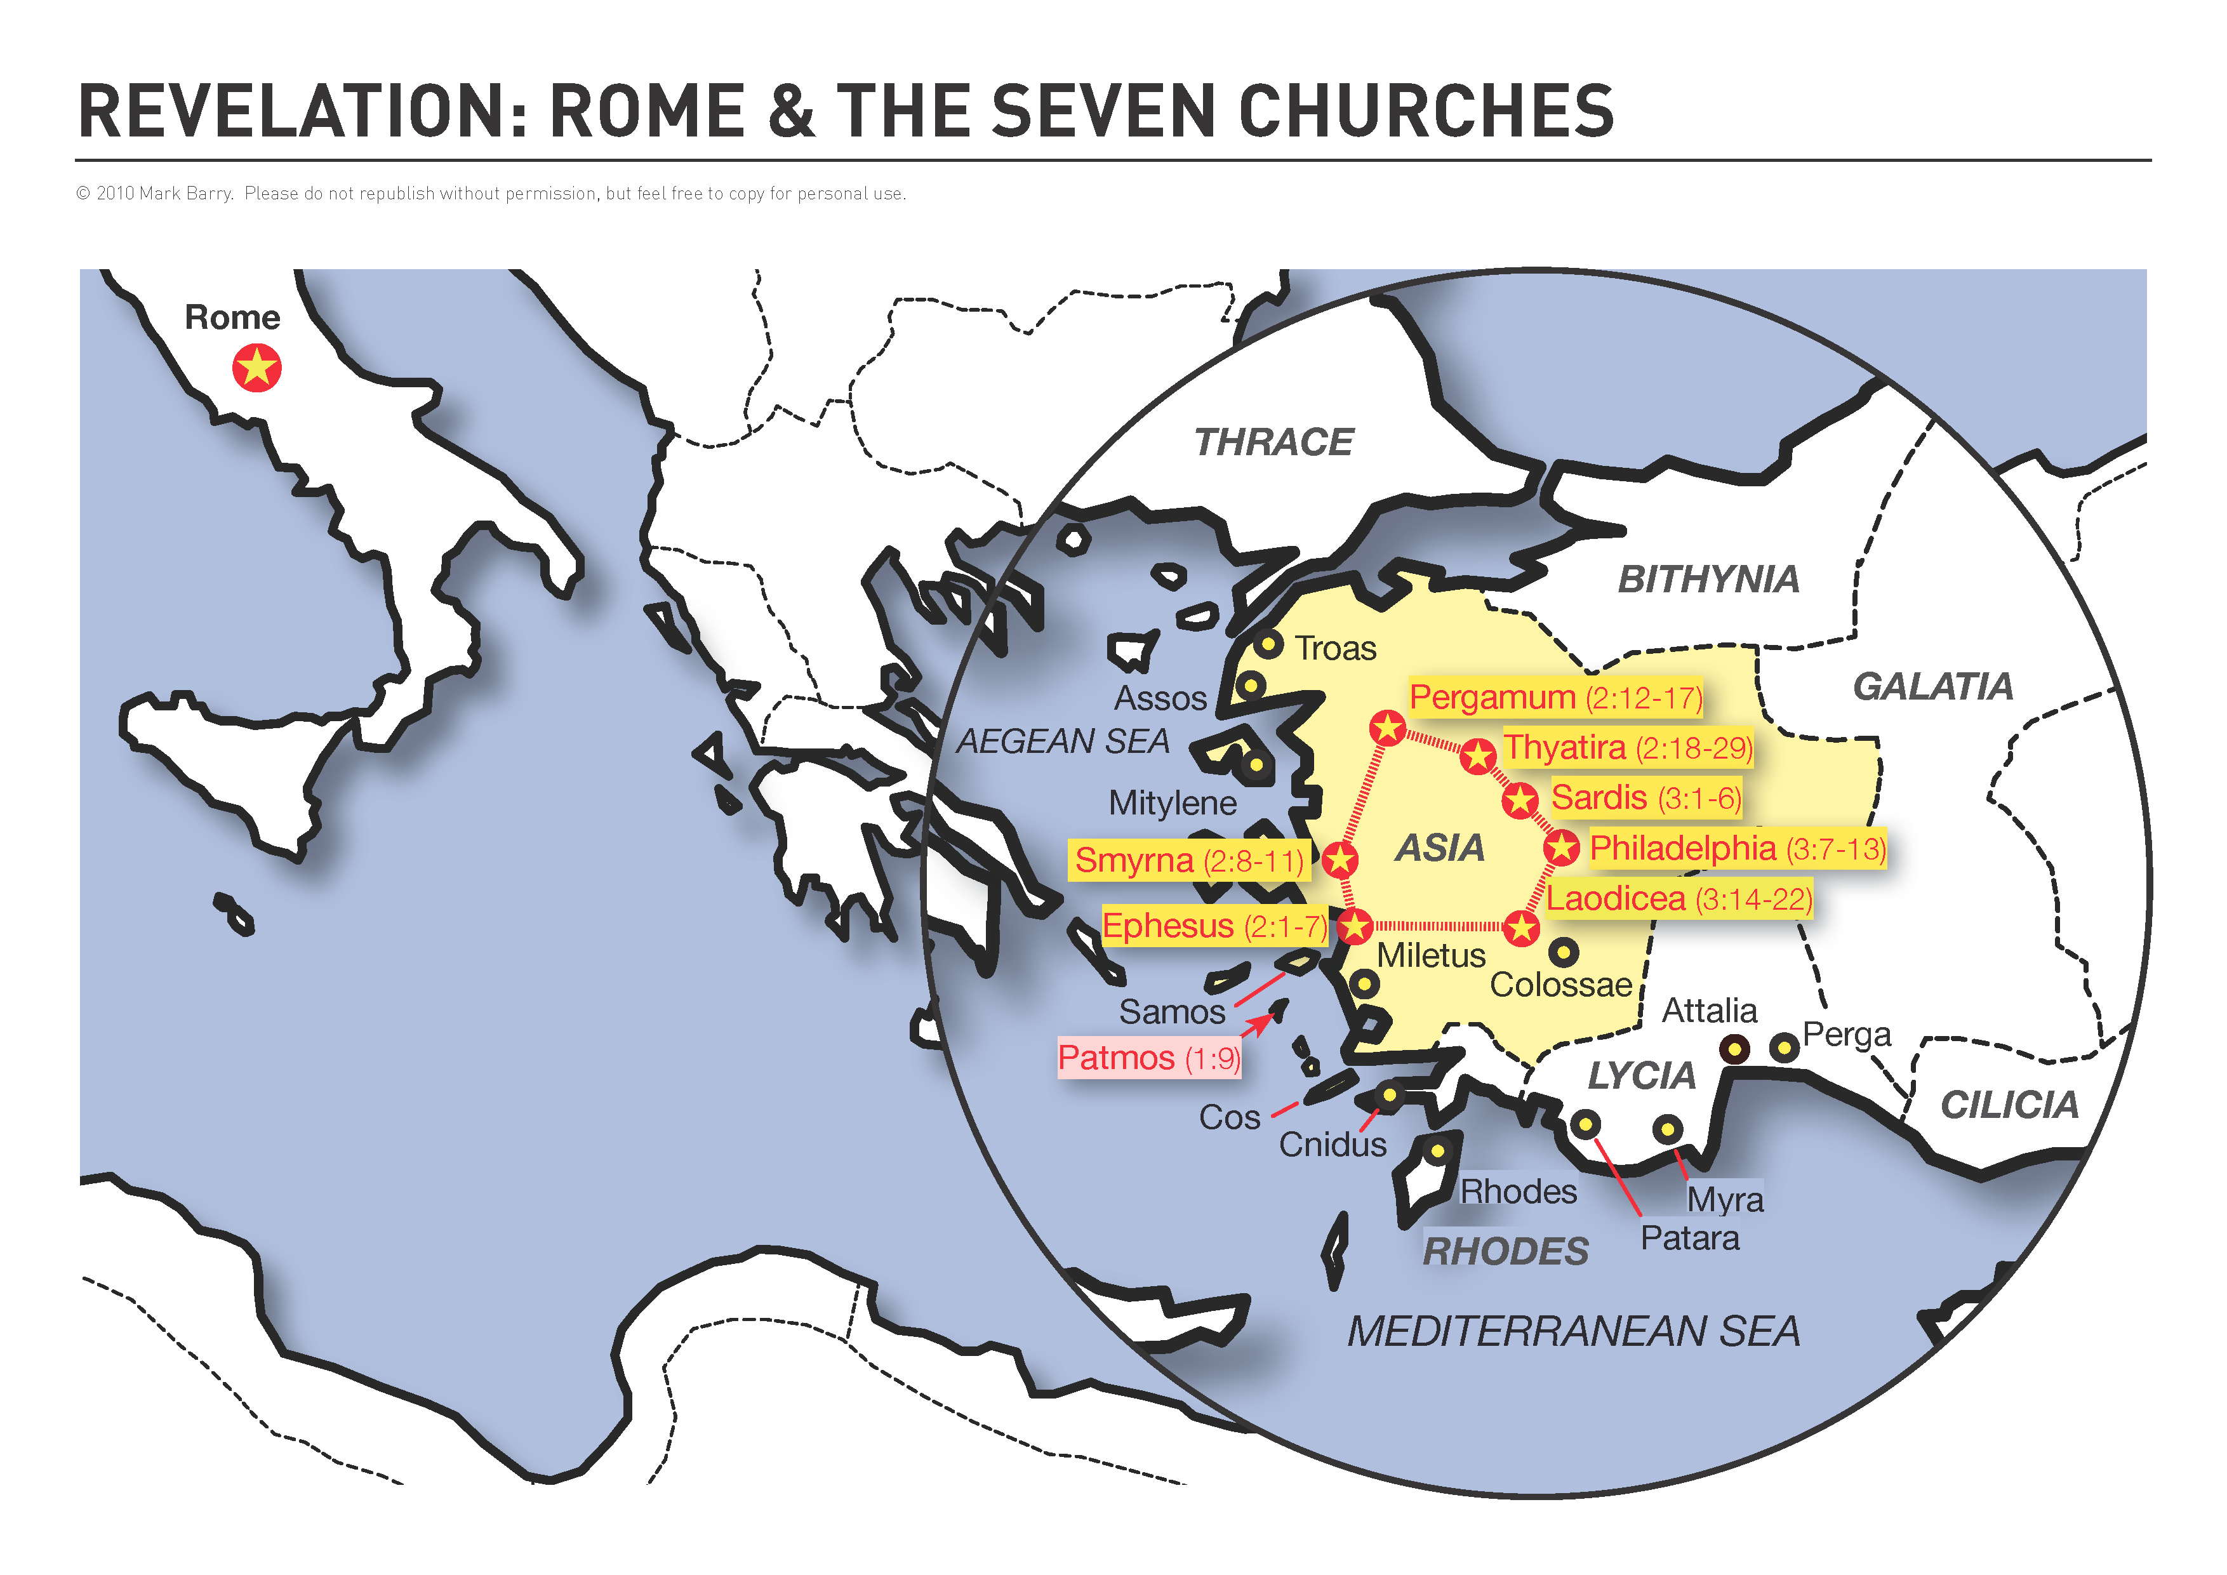

Slide 4
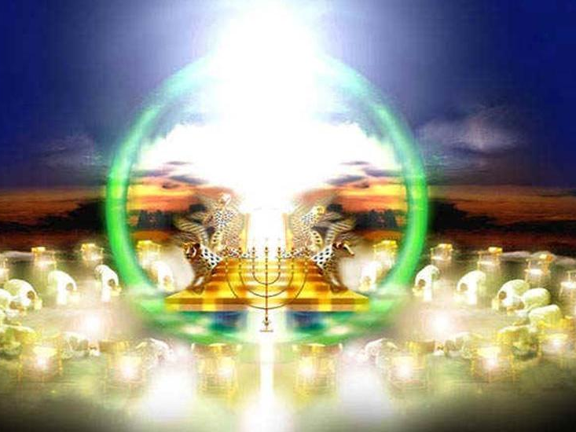

Slide 6
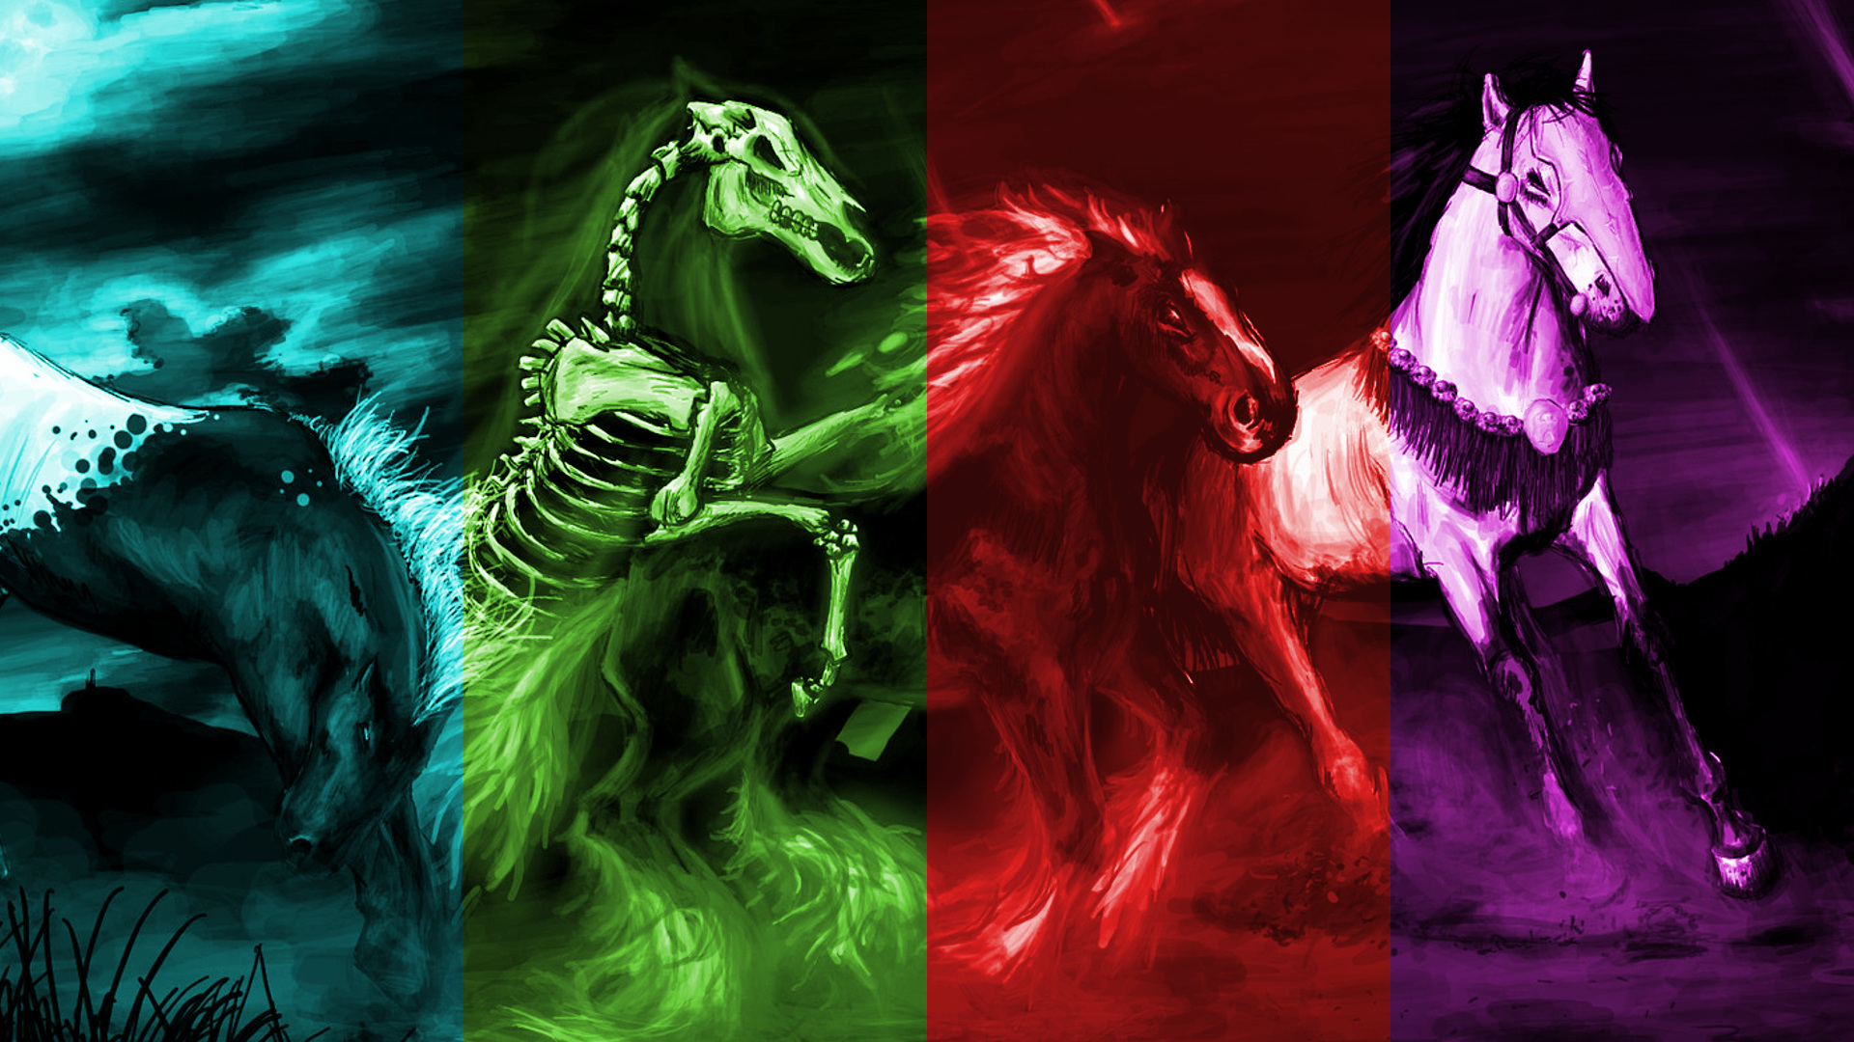

Slide 7
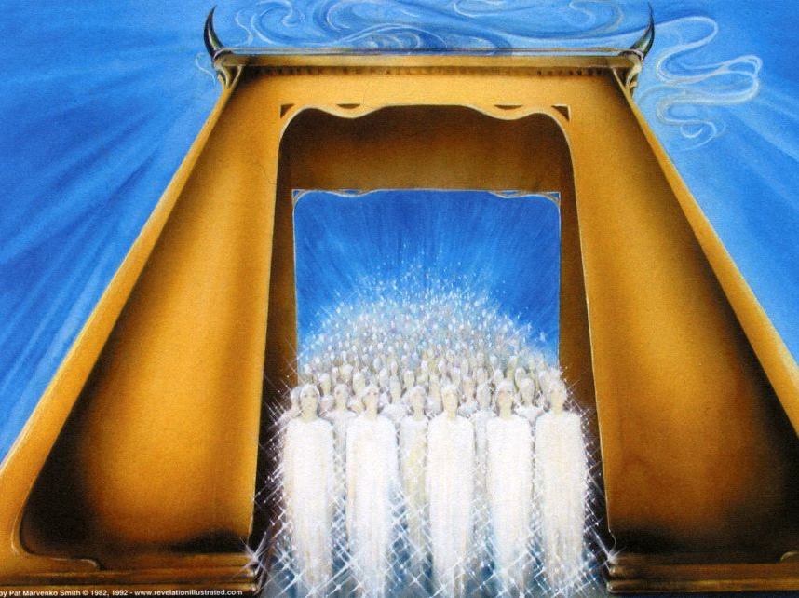

Slide 8
Preterist
Revelation’s prophecies have largely already come to pass (except for the final judgement and full restoration found in Revelation 20-22).
100
500
1000
1500
2020

Slide 9
Historicist
In studying Revelation, we are studying a symbolic depicture of the most important events in global history from the first century until the return of Christ.
100
500
1000
1500
2020

Slide 10
Futurist
Revelation’s prophecies have NOT been fulfilled yet, and will only come to pass during the final generation before Jesus returns.
100
500
1000
1500
2020

Slide 11
Idealist
Revelation is a depiction of the kingdom of God against the kingdom of darkness that will speak to Christians in any time and location, and offer them hope in light of the return of Jesus.
100
500
1000
1500
2020

Slide 13
TOXIC THEOLOGY

Slide 14
Toxic theology is often fixated on a few main texts/themes.
TOXIC THEOLOGY

Slide 15
Toxic theology promotes speculation and arguments.
TOXIC THEOLOGY

Slide 16
Toxic theology doesn't facilitate joy and enjoyment of creation.
TOXIC THEOLOGY

Slide 17
Toxic theology doesn’t value questioning.
TOXIC THEOLOGY

Slide 18
Toxic theology is
non-wholistic.
TOXIC THEOLOGY

Slide 19
Toxic theology pairs precise doctrine with precise expression of the doctrine.
TOXIC THEOLOGY

Slide 20
Toxic theology gives prominence to one or two main teachers.
TOXIC THEOLOGY

Slide 21
Toxic theology leads you to focus on others sin more than your own.
TOXIC THEOLOGY

Slide 22
Toxic theology is anti-intellectual / integrationist.
TOXIC THEOLOGY

Slide 23
Toxic theology does not attend to the entire range of human emotion.
TOXIC THEOLOGY

Slide 24
Toxic theology emphasizes moralism and personal religious performance.
TOXIC THEOLOGY

Slide 25
Toxic theology often presents itself as aHistorical.
TOXIC THEOLOGY

Slide 26
Toxic theology is more concerned about outside of the cup than the interior state.
TOXIC THEOLOGY

Slide 27
Toxic theology is primarily motivated by fear, anger, suspicion.
TOXIC THEOLOGY

Slide 28
Toxic theology operates from a fundamental view of God as a cold, harsh, distant taskmaster.
TOXIC THEOLOGY

Slide 29
Toxic theology breeds fatalism/pessimism.
TOXIC THEOLOGY

Slide 30
Toxic theology is isolationist at many levels.
TOXIC THEOLOGY

Slide 31
Toxic theology has difficulty embracing change or a diversity of expressions of discipleship.
TOXIC THEOLOGY

Slide 32
We can fall prey to toxic theology, especially during a pandemic.
We can nurture a toxic theology, especially during a pandemic.
TOXIC
THEOLOGY

Slide 33
1. Disconnect from sources of toxic theology.
2. Put a HSMS learning plan in place.
3. Befriend and listen carefully to not-like-you-Christians.
4. Grapple with ideas. Love and bless people.

