Slide 1
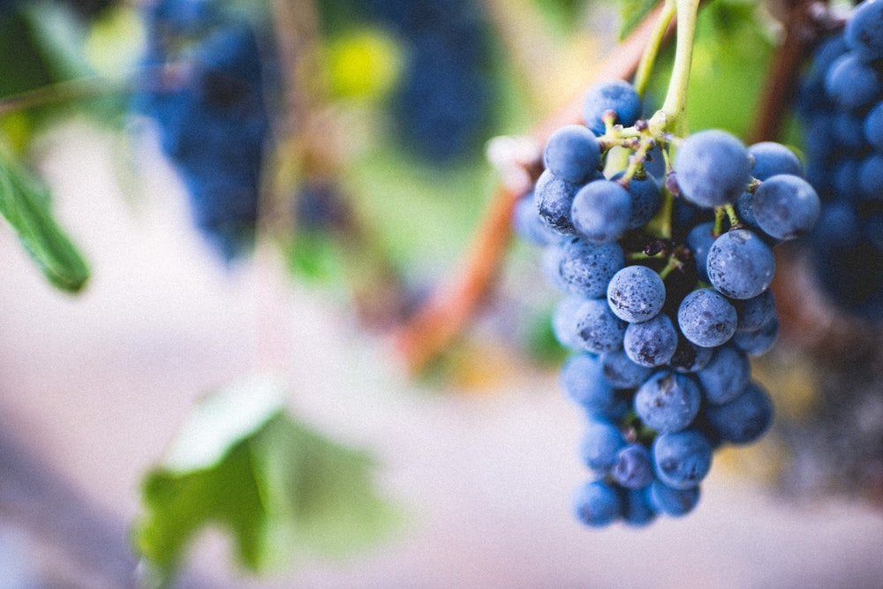
ABIDE

Slide 2
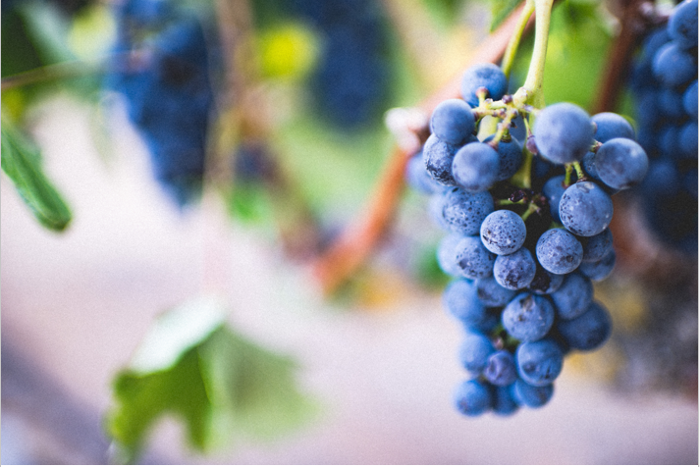
¹ “I am the true vine, and my Father is the gardener. ² He cuts off every branch in me that bears no fruit, while every branch that does bear fruit he prunes so that it will be even more fruitful. ³ You are already clean because of the word I have spoken to you.

Slide 3
⁴ Remain in me, and I will remain in you. No branch can bear fruit by itself; it must remain in the vine. Neither can you bear fruit unless you remain in me. ⁵ “I am the vine; you are the branches. If a man remains in me and I in him, he will bear much fruit; apart from me you can do nothing.

Slide 4
⁶ If anyone does not remain in me, he is like a branch that is thrown away and withers; such branches are picked up, thrown into the fire and burned. ⁷ If you remain in me and my words remain in you, ask whatever you wish, and it will be given you. ⁸ This is to my Father’s glory, that you bear much fruit, showing yourselves to be my disciples.

Slide 5
⁹ “As the Father has loved me, so have I loved you. Now remain in my love. ¹⁰ If you obey my commands, you will remain in my love, just as I have obeyed my Father’s commands and remain in his love. ¹¹ I have told you this so that my joy may be in you and that your joy may be complete.

Slide 7
⁴ Remain in me, and I will remain in you. No branch can bear fruit by itself; it must remain in the vine. Neither can you bear fruit unless you remain in me.

Slide 8
Abiding = Fruitfulness

Slide 9
⁴ Remain in me, and I will remain in you. No branch can bear fruit by itself; it must remain in the vine. Neither can you bear fruit unless you remain in me. ⁵ “I am the vine; you are the branches. If a man remains in me and I in him, he will bear much fruit; apart from me you can do nothing.

Slide 10
Not Abiding = Unfruitfulness or “fruit for death.”

Slide 11
Mark 4:19 (Parable of the Sower) ¹⁹ but the worries of this life, the deceitfulness of wealth and the desires for other things come in and choke the word, making it unfruitful.
Romans 7:5
⁵ For when we were controlled by the sinful nature, the sinful passions aroused by the law were at work in our bodies, so that we bore fruit for death.

Slide 13
How to Abide in Jesus
Build rituals
Maintain accountability
Grow through hardships
Practice spiritual disciplines
Establish all activity in the gospel of grace

Slide 14
Mark 4:19 (Parable of the Sower) ¹⁹ but the worries of this life, the deceitfulness of wealth and the desires for other things come in and choke the word, making it unfruitful.
Romans 7:5
⁵ For when we were controlled by the sinful nature, the sinful passions aroused by the law were at work in our bodies, so that we bore fruit for death.

Slide 15
Mark 4:19 (Parable of the Sower) ¹⁹ but the worries of this life, the deceitfulness of wealth and the desires for other things come in and choke the word, making it unfruitful.
Romans 7:5
⁵ For when we were controlled by the sinful nature, the sinful passions aroused by the law were at work in our bodies, so that we bore fruit for death.

